Slide 1
PERINATAL OUTCOMES IN STAGE II FETAL GROWTH RESTRICTION
Dr Nibedita Maharana, Dr Sweta Singh, Dr Jasmina Begum, Dr Subarna Mitra
Department of Obstetrics and Gynaecology
All India Institute of Medical Sciences, Bhubaneswar

Slide 2
INTRODUCTION
Doppler velocimetry is used extensively in prenatal assessment of fetal well-being in high risk pregnancies¹
Fetal growth restriction (FGR), a subset of high risk pregnancy, is a common cause of perinatal morbidity and mortality, especially in developing countries²
The Stage based management protocol (Barcelona protocol) for FGR was first proposed in 2014 ²
In this, Stage II FGR with absent-end diastolic velocity (AEDV) in Umbilical Artery (UA) indicates severe placental insufficiency, which may lead to fetal death, stillbirth, neonatal complications like respiratory distress syndrome, necrotizing enterocolitis, intraventricular haemorrhage, perinatal mortality, and long-term neurodevelopmental impairment. ^{2,3}

Slide 3
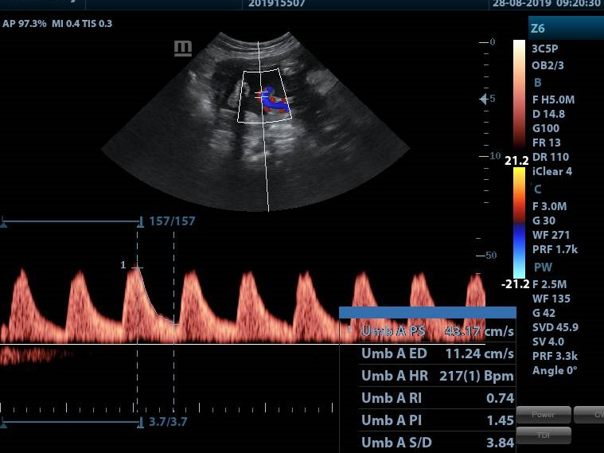
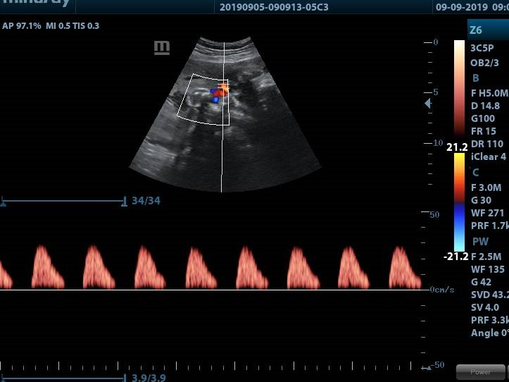
OBJECTIVES
Against this background, the objective of our case series is:
To describe the perinatal outcomes in the subset of women with Stage II FGR diagnosed antenatally
To describe the associated maternal complicating factors in these women with Stage II FGR

Slide 4
METHODOLOGY
Study setting :Department of Obstetrics & Gynaecology, AIIMS BBSR
Study design: Retrospective cohort study
Study duration: From July 2019 to January 2020 (6 months)
Inclusion criteria: All women with AEDF on UA Doppler after standardized ultrasound examination at AIIMS BBSR
Exclusion criteria: Incomplete data
Ethics clearance: Not deemed necessary
Protocol: Standard protocol of frequent fetal Doppler assessment, administration of corticosteroids ( 4 doses of dexamethasone if terminated before 36 week) and magnesium sulphate ( if terminated before 34 week) before delivery was followed in all cases

Slide 5
RESULTS 9 women with Stage II FGR were included in this analysis
 | Case 1 | Case 2 | Case 3 | Case 4 | Case 5 | Case 6 | Case 7 | Case 8 | Case 9
Age (year) | 31 | 32 | 30 | 30 | 30 | 20 | 23 | 25 | 34
Obstetric Score | G1 | G1 | G4A3 | G1 | G1 | G2A1 | G1 | G1 | G2A1
Associated pregnancy complications | Chronic HTN with superimposed PE, FGR | PE, FGR | Chronic HTN with superimposed PE, FGR | Chronic HTN with superimposed PE FGR | Chronic HTN, PE, FGR HTN retinopathy, Diabetes mellitus | FGR, PE | GDM, FGR, TB meningitis | FGR, Scrub typhus, Beta Thalassemia trait | FGR Overt DM Epilepsy
GA at first detection of AEDF (week) | 28 | 29 | 29⁺² | 28⁺¹ | 27⁺⁵ | 35⁺⁵ | 34 | 32⁺² | 31⁺²
GA at reversal of flow (week) | 31⁺¹ | 31⁺⁶ | 30⁺² | 29⁺⁵ | 29⁺² |  | - | 33 | 32⁺⁴

Slide 6
RESULTS…
 | Case 1 | Case 2 | Case 3 | Case 4 | Case 5 | Case 6 | Case 7 | Case 8 | Case 9
GA ( weeks) at termination of pregnancy | 31⁺¹ | 31⁺⁶ | 30⁺³ | 29⁺⁵ | 29⁺² | 36 | 34⁺² | 33 | 32⁺⁵
Birth weight of baby (gram) | 830 | 840 | 1025 | 960 | 840 | 1775 | 920 | 1500 | 1050
Apgar score at 1, 5 min | 5, 8 | 6, 7 | 6, 8 | 6, 8 | 4, 7 | 9, 9 | 9, 10 | 7, 9 | 7, 9
NICU admission (days) | 42 | 40 | 28 | 34 | 38 | 2 | 33 | 7 | 22
Follow up (month) | 3 | 3 | 3 | 3 | 3 | 3 | 3 | 3 | 3
Associated congenital malformations | Nil | Nil | Nil | Nil | Nil | Nil | Nil | Nil | Nil

Slide 7
RESULTS: SUMMARY
Nine (9) women with FGR Stage II were analysed
The median gestation of appearance of AEDF was 29.2 weeks
The average time from appearance of absence to reversal of UA flow was 1 weeks 6 days
Seven (7/9) cases were terminated before 34weeks as there was reversal of end diastolic flow
FGR Stage II was associated with maternal:
Chronic hypertension (4/9 cases)
Preeclampsia ( 2/9 cases)
GDM with TB meningitis (1/9 case)
Scrub typhus with beta-thalassemia trait (1/9 case)
Epilepsy with overt diabetes (1/9 case)

Slide 8
RESULTS: SUMMARY
In all cases, the mode of termination was lower segment caesarean section
All babies had low birth weight, contributing to longer NICU admission
Extremely low birth weight babies (<1000gram) :5/9 babies
Very low birth weight (<1500gram): 2/9 babies
Low birth weight babies ( 1500-2500 gram): 2/9 babies
The mean NICU admission for extremely low birth weight babies was 37.4 days
All the babies were followed up after 3 month age and found to be healthy
There were no neonatal deaths
No congenital anomalies were detected in any of the babies

Slide 9
DISCUSSION
The absence or reversal of end diastolic flow in the umbilical artery Doppler undoubtedly indicates a high-risk fetus requiring intense fetal surveillance, judicious and expeditious delivery⁴
Although immediate delivery may not be indicated, the consensus says intensive fetal surveillance should be initiated with strong consideration given to early delivery if conditions get worsened
Obstetric challenge in the management consists of ascertaining the optimal time of delivery by weighing the risks of prematurity against the risks of a potentially hostile intrauterine environment.⁵

Slide 10
DISCUSSION
Absent or reversed end diastolic flow in the umbilical artery is associated with perinatal complication like intraventricular haemorrhage, bronchopulmonary dysplasia, respiratory distress syndrome, necrotizing enterocolitis, and long-term neurodevelopmental impairment³
However preterm birth, spontaneous or iatrogenic, is also associated with a significant increased risk of neonatal morbidity and mortality⁶
Treatment with antenatal corticosteroids decreases RDS, and IVH in preterm infant, with a significant reduction in the incidence of neonatal necrotising enterocolitis and systemic infections in the first 48 hours of life, as well as reducing the need for respiratory support and NICU admission.⁷

Slide 11
DISCUSSION
Intrauterine fetal jeopardy as well as prematurity are frequently associated with neurological outcomes like cerebral palsy and long term cognitive impairments⁸
The risk of cerebral palsy is increased by 30–80-fold in infants born before 30 weeks compared to term infants.⁹
We considered administration of magnesium sulphate till 33 ⁺⁶ weeks as per NICE guidelines.¹⁰
Though babies in our study were delivered preterm with a birth weight less than the desirable, timely delivery and judicious administration of antenatal corticosteroid and magnesium sulphate led to a better neonatal outcome
Close fetal surveillance remained the key to the successful outcome.

Slide 12
CONCLUSION
Placental insufficiency due to maternal chronic hypertension was the most frequent cause of FGR
The only known effective treatment of FGR is delivery, and, therefore, in order to improve the clinical outcome, a timely recognition of FGR and an optimal timing of the delivery are crucial
The gestational age at birth also plays a fundamental role in the neonatal outcome in the case of FGR
According to the evidence available today, Doppler study of the umbilical arteries (UAs) is the only test that has shown to improve the outcome, reducing perinatal mortality and reducing obstetric interventions

Slide 13
REFERENCES
Fleischer A, Schulman H, Farmakides G, Bracero L, Blattner P, Randolph G. Umbilical artery velocity waveforms and intrauterine growth retardation. Am J Obstet Gynecol 1985; 151: 502–6.
Francesc Figueras Eduard Gratacós; Update on the Diagnosis and Classification of Fetal Growth Restriction and Proposal of a Stage-Based Management Protocol; Fetal Diagn Ther 2014;36:86–98.
Kuo-Gon Wang, Chen-Yu Chen, Yi-Yung Chen: The effects of absent or reversed end-diastolic umbilical artery doppler flow velocity: Taiwan J Obstet Gynecol • September 2009 • Vol 48 • No 3
Peter McParland, Shirley Steel and J. Malcolm Pearce; The clinical implications of absent or reversed end-diastolic frequencies in umbilical artery flow velocity waveforms; European Journal of Obstetrics & Gynecology and Reproductive Biology, 31 (1990) 15-23
Lecarpentier E, Cordier AG, Proulx F, Fouron JC, Gitz L, et al. Hemodynamic Impact of Absent or Reverse End-Diastolic Flow in the Two Umbilical Arteries in Growth-Restricted Fetuses.2013. PLoS ONE 8(11): e81160.
Liu L, Johnson HL, Cousens S, Perin J, Scott S, Lawn JE, et al. Global, regional, and national causes of child mortality: an updated systematic analysis for 2010 with time trends since 2000. Lancet 2012; 379:2151–61.
Roberts D, Brown J, Medley N, Dalziel SR; Antenatal corticosteroids for accelerating fetal lung maturation for women at risk of preterm birth. Cochrane Database of Systematic Reviews 2017, Issue 3. Art. No.: CD004454.
Mwaniki MK, Atieno M, Lawn JE, Newton CR. Long-term neurodevelopmental outcomes after intrauterine and neonatal insults: a systematic review. Lancet 2012; 379:445–52.
Anderson P, Doyle LW. Neurobehavioral outcomes of school-age children born extremely low birth weight or very preterm in the 1990s. J Am Med Assoc 2003; 289:3264–72.
Guideline committee. Preterm Labour and Birth. In: Guideline No 25 ed: National Institute for Health and Care Excellence; 2015.

Slide 14
Thank you!

