Slide 1
ATYPICAL PRESENTATION OF BLADDER LEIOMYOMA-DYSPARENUIA

Slide 2
INTRODUCTION
Leiomyoma of the urinary bladder is rare tumour of bladder.
Benign mesenchymal neoplasm of urinary bladder.
Accounts for 0.43% of all bladder tumors.
First reported by Virchow in 1931
Only 250 case reports have been reported in literature worldwide.

Slide 3
Etiology is still unknown. Estrogen may be associated with growth as immuno-histochemical and pathological findings are same as that of uterine leiomyoma.
Bladder leiomyoma can be intravesical (51.1%), intramural (30%), and extravesical (16.7%)
20% of Bladder leiomyoma can be asymptomatic.
Most common presenting symptoms reported are obstructive symptoms, irritative symptoms or hematuria.
We report a case of bladder leiomyoma presenting with dysparenuia and abdominal mass.

Slide 4
A 42 years old multiparous woman presented to gynecological OPD with complains of dysparenuia and suprapubic abdominal mass, more so for last 5-6 months. There was no significant medical or surgical history . She gave history of slight increase in frequency of micturition from last 3 months. There was no history of vaginal discharge and her menstrual history was normal.

Slide 5
On abdominal examination, a suprapubic mass was found with upper limit up to umbilicus ,firm in consistency, slightly more towards right side.
Vaginal examination revealed cervix was backwards , uterus was multiparous in size, firm in consistency non tender . In close association with uterus on right side there was a mass equivalent to 20 weeks size pregnant uterus was felt , one lobe of this mass was protruding in vagina. Left fornix was free.
On USG, a 16× 12 cm homogenous mass with regular contour present in right broad ligament suggestive of fibroid.

Slide 6
Patient underwent laparotomy with diagnosis of broad ligament fibroid
Incidentally, a subpedunculated leiomyoma was found anterior to urinary bladder. Uterus and both tubes and ovaries were normal.(Shown in pic)
The same tumour was enucleated and patient was discharged in good health
.On follow up patient is free of all symptoms.

Slide 7
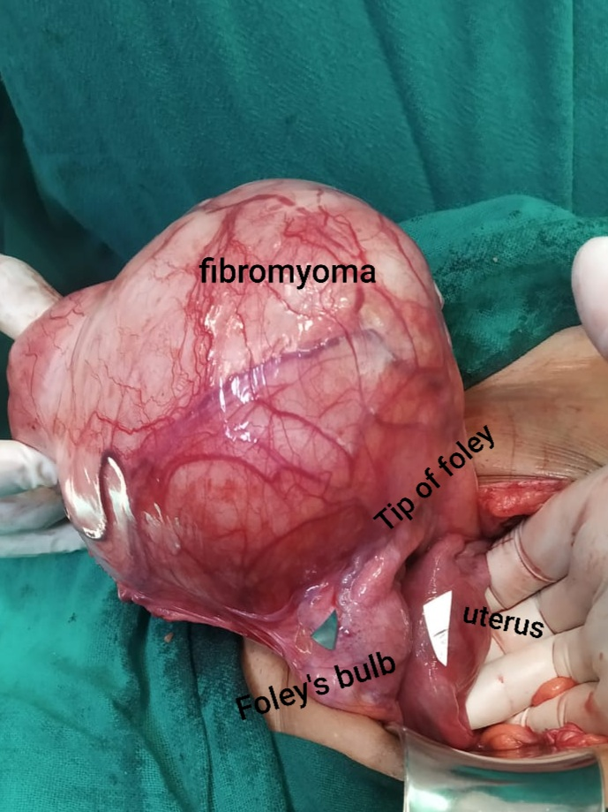
INTRAOPERATIVE PRESENTATION OF BLADDER LEIOMYOMA

Slide 8
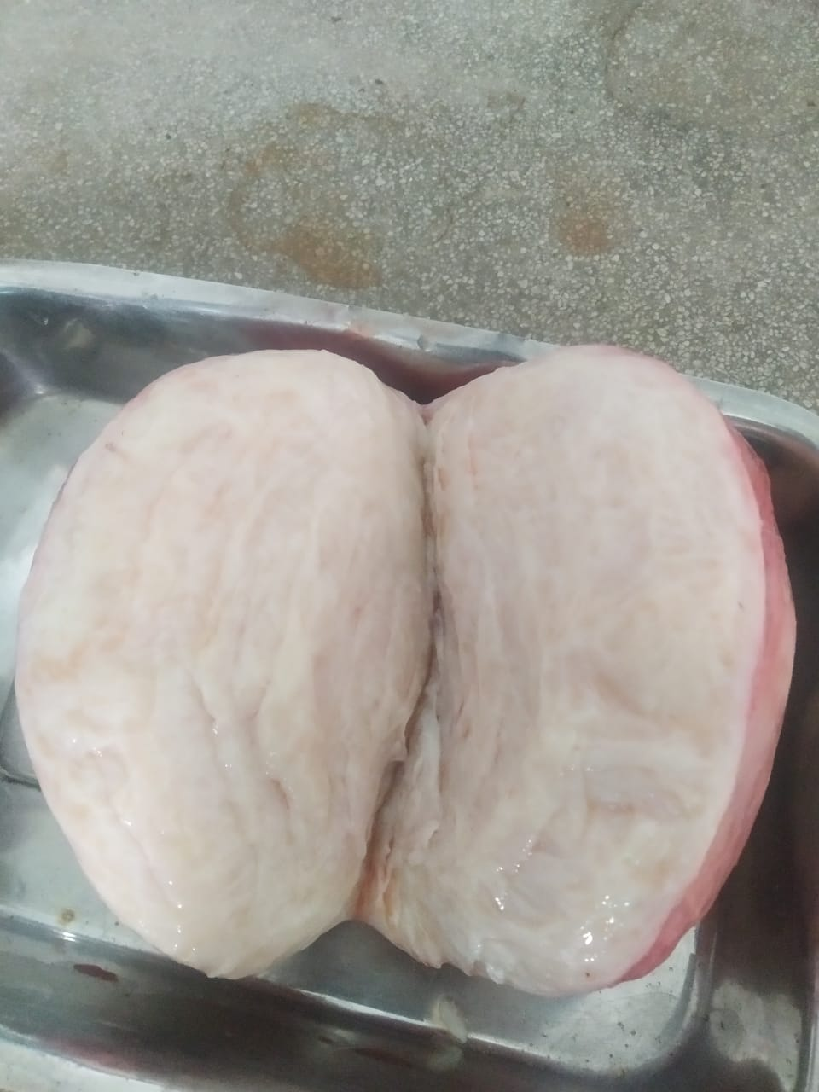
GROSSLY, MASS IS WHITE- GREY WITH WHORLED APPEARENCE

Slide 9
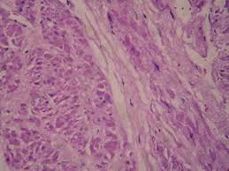
BLADDER LEIOMYOMA COMPOSED
OF INTERSECTIN
FASCICLES OF SMOOTH MUSCLE
(Hematoxylin and eosin)

Slide 10
DISCUSSION
Leiomyoma is a benign smooth muscle tumor, can arise from any organ besides uterus
Female are affected more, 70% of bladder leiomyoma were presented in female
USG bladder and cystoscopy are primary modality of investigation
MRI is preferred for further information about size, location, composition and extension of tumor
The definitive diagnosis of bladder leiomyoma requires histopathology

Slide 11
CONCLUSION-
Traditionally, the cause of dyspareunia may include physical and psychological issues which can be difficult sometimes to pin point. However, it is necessary to take into account the possibility that the coexisting bladder and uterine leiomyomas may have an unusual clinical manifestation such as dyspareunia.
Besides urinary tract symptoms the urinary bladder leiomyoma can present with unusual complaints like dyspareunia especially the extravesical type of leiomyoma which are
detected late when they are large enough.

