Slide 1
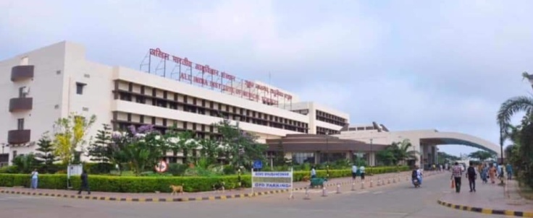
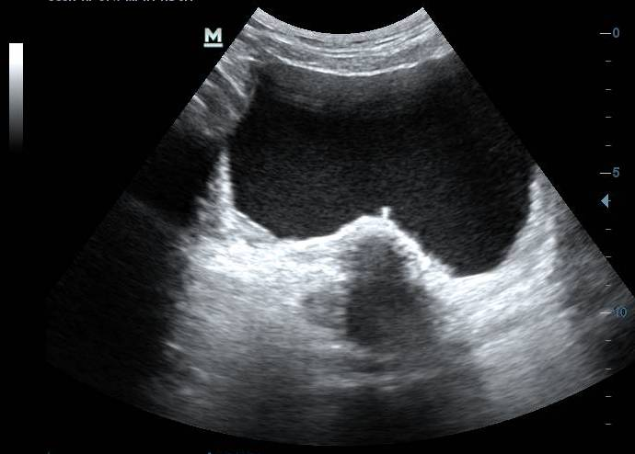
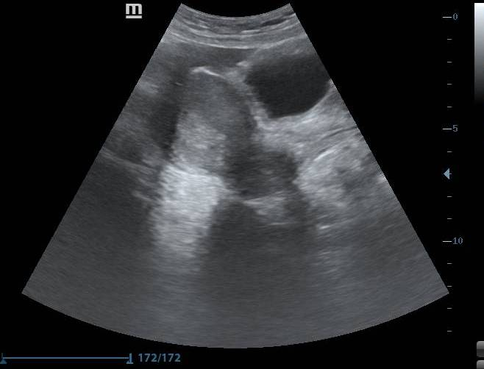
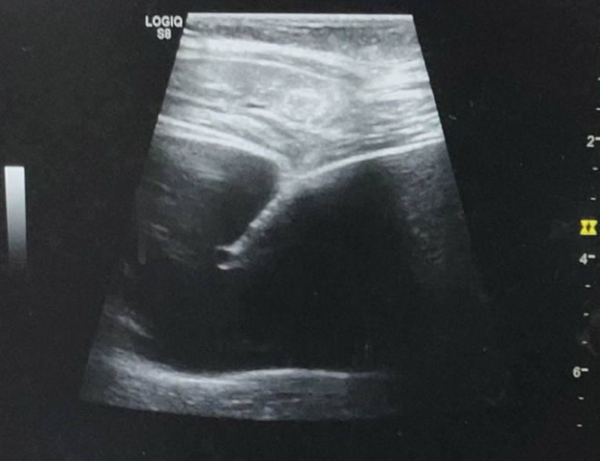
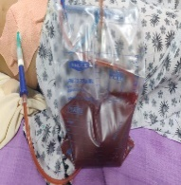
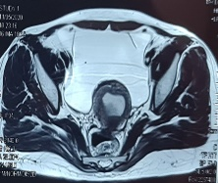
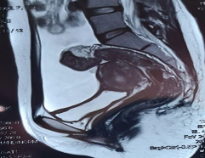
TITLE: RECURRENT SPONTANEOUS HEMOPERITONEUM IN ENDOMETRIOSIS: MANAGEMENT AND CHALLENGES DURING THE COVID-19 PANDEMIC AUTHORS: DR ADITYA PATI¹, DR SWETA SINGH¹, DR SUDIPTA MOHAKUD², DR MANAS KUMAR PANIGRAHI³, DR ASHUTOSH PANIGRAHI⁴ DEPARTMENTS OF OBSTETRICS AND GYNAECOLOGY¹,RADIOLOGY²,GASTROENTEROLOGY³, HEMATOLOGY⁴, ALL INDIA INSTITUTE OF MEDICAL SCIENCES BHUBANESWAR,BHUBANESWAR, INDIA
Introduction:
Spontaneous hemoperitoneum in endometriosis is rare.¹
We present here the case of a nulliparous woman, who presented with recurrent spontaneous hemoperitoneum, and discuss the management and challenges faced during the COVID-19 pandemic.
Result:
Upon presentation, her vitals were stable and pallor was present.
There was mild abdominal distension.
Ultrasonography revealed significant haemoperitoneum,and MRI confirmed endometriosis. Her hemoglobin was 6.8g%, urine pregnancy test was negative and coagulation profile was normal. She received 1 unit of packed cell transfusion.
In view of COVID-19 pandemic and stoppage of elective laparoscopic surgeries, imaging guided pig tail catheter insertion and drainage was performed. Around 3.7 litres of haemorrhagic fluid was drained.
Tubercular and bleeding disorder workup was negative. She was started on continuous OCPs and at 2 months follow up, she was asymptomatic with the minimal ascites.
Discussionn:
MRI has greater specificity in the diagnosis of endometriosis.²
Hemoperitoneum predisposes to deep infiltrating endometriosis.
During the COVID-19 pandemic with stoppage of elective laparoscopic surgeries, alternative methods of management have to be adopted.
References:
Gonzalez A, Artazcoz S, Elorriaga F, Palin H, Carungo J. Massive recurrent hemoperitoneum with encapsulating peritonitis: another enigmatic clinical feature of endometriosis. FertilSteril 2019; 112: 1190-1192
Siegelman ES, Oliver ER. MR imaging of endometriosis: ten imaging pearls. Radiographics. 2012; 32:1675-91
Case:
A 28 year old nulliparous woman was referred with abdominal distension and pain.
Her last menstrual period was 20 days back.
She had been evaluated earlier for primary subfertility.
Diagnostic hysterolaparoscopy had been performed in 2015, where frozen pelvis was documented. S
Subsequently, she underwent 2 emergency laparoscopic procedures for hemoperitoneum, and histopathology of the right ovarian cystectomy specimen revealed ruptured corpus luteum.
She had received a course of empirical antitubercular therapy.
Paracentesis had been performed 5 times previously.
1
2
5
6
3
4
3
3
4
Figure:1,2. .USG on presentation; ,3,4. MRI showing Acites and Endometrioma,5. Pigtail catheter insertion under USG guidance,6..Drainage of hemorrhagic fluid via pigtail catheter

