Slide 1
MULLERIAN ANOMALY AND ASSOCIATED MULTISYSTEM ABNORMALITIES :A RARE CASE REPORT
DR PRAGYAN PARAMITA PRADHAN
DR PUSHPAWATI THAKUR
DR SARITA RAJBHAR
DR YARANG

Slide 2
INTRODUCTION
Mullerian development defects are some of the most fascinating disorders encountered in gynaecology which may result from abnormal formation, fusion or reabsorption of the Müllerian ducts during fetal life.Incidence of Mullerian anomalies is 1-3% in general population.
The process may be partial or total and can have associated urinary tract anomalies as there is close embryologic relation exists between the development of the urinary and reproductive organs.

Slide 3
Rarely other anomalies of cardiovascular , gastrointestinal and axial skeletal system can be present along with mullerian and renal anomalies
In a case scenario described by Indranil Banerjee et al. a 19 year old girl had unicornuate uterus with right chocolate cyst ,with history of rectal atresia ,VSD, right renal agenesis.[1]
Here is such a rare case involving multisystem abnormalities managed successfully at AIIMS ,Raipur.

Slide 4
CASE REPORT
A 20 year married nulligravida female came to AIIMS OPD with complain of chronic lower abdominal pain for 6 months and a lump abdomen since 4 months.
She was a known case of moderate aortic stenosis with bicuspid aortic valve with outside USG done 3 months back s/o right sided pelvic kidney and right complex adenexal mass .
She had underwent laparotomy 2 month back outside where removal of right sided ectopic kidney was done .However they were not able to remove the cyst and was hence referred to higher centre.

Slide 5
COMPLEX RIGHT ADENEXAL CYST

Slide 6
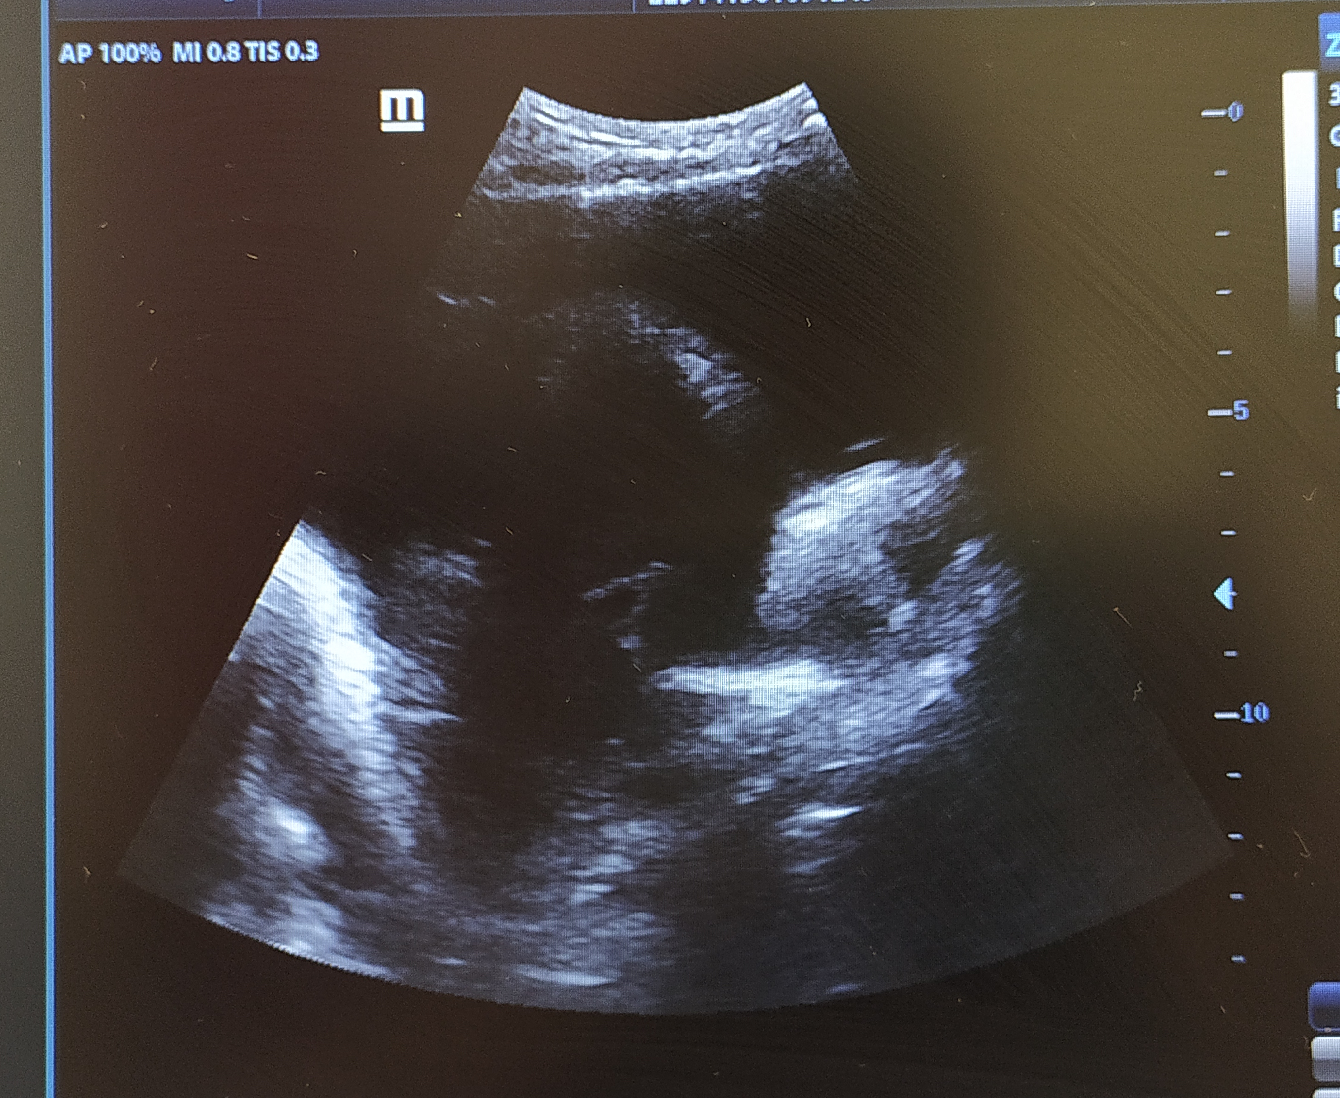
ENDOMETRIOTIC CYST

Slide 7
She was evaluated at AIIMS .All tumor markers were normal except CA 125 which was raised .CECT suggested of complex midline mass (?hydrosalpinx /pyosalpinx) and left ovarian cyst with segmentation anomalies in lower lumber vertebra and single left kidney.
After proper preoperative evaluation, cardiology ,urology opinion at AIIMS and PAC clearance she underwent laparoscopic evaluation .Due to dense adhesions between bladder ,bowels and the endometriotic cyst decision for laparotomy was taken.

Slide 8
ENDOMETRIOTIC CYST

Slide 9
UNICORNUATE UTERUS AND RUDIMENTARY HORN

Slide 10
Intra operatively there was unicornuate uterus with left sided rudimentary horn (ASRM type II Mullerian anomaly) and a 8x8 cm right ovarian endometriotic cyst.
There was also malrotation of gut and meckel’s diverticulum.
Adhesions were released followed by excision of rudimentary horn and preservation of functioning uterus. Right ovarian endometriotic cyst excision was done.
Post operatively 1 unit PRBC transfusion was done and patient was shifted to ICU for a day for observation.
Rest of post op period was uneventful and she was discharged on day 5.

Slide 11
FOLLOW UP
At discharge patient was put on GnRH agonist (inj leuprolide ) for 3 months.
Subsequent follow ups of the patient for 3 months were normal.

Slide 12
Conclusion
The uniqueness of the above reported case lies in the fact that there were abnormalities of multiple systems like cardiac ,renal ,genital, skeletal and gastrointestinal .
Each of the abnormalities required proper evaluation .
Hence it is recommended that in every case of Mullerian anomaly other systems also need to be evaluated properly to detect and manage those abnormalities in time.
REFERENCE
1.Banerjee I, Dam P, Roy SD. Mullerian Developmental Defect Along with Multisystem Abnormalities: A Rare Case with Rare Association. Int J Sci Stud 2015;2(12):201-203.-

