Slide 1
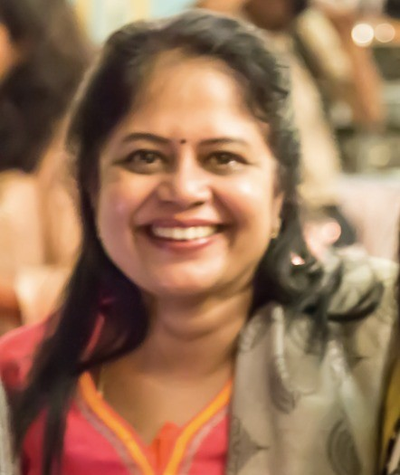
Charmila Ayyavoo MD DGO DFP FICOG PGDCR
MBBS -Coimbatore Medical College
MD- Grant Medical College, Mumbai
Chairperson, Clinical Research Committee, FOGSI 2016-18
ICOG Governing council member 2021-23
National Coordinator, UNICEF FOGSI PCA
National coordinator, Medha FOGSI PG program
WHO SEARO MDSR India member 2021
Past Secretary Trichy OG Society
President Menstrual Hygiene Management Consortium 2018-20
Joint Secretary, Gestosis India Association
Joint Treasurer, IFS, Tamilnadu Chapter

