Slide 1
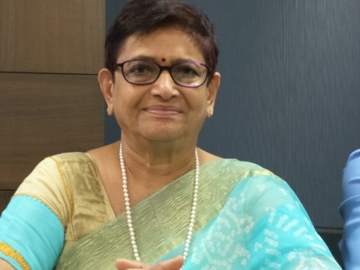
JAYAM KANNAN MD.Dgo,FICOG | Emeritus professor: TamilNadu Mgr Medical University Vice president FOGSI INDIA 2018 adolescent health committee CHAIR FOGSI” 2013-2015, best committee awardee FOUNDER SECRETORY.TAMILNADU FEDERATION OF OBGYNS 2007-2014 Founder member GESTOSIS INDIA Society
1.President ~ --------------- 2.Member ~----------------- 3.Course director ~------------ | Free Legal Aid Centre for Women trichy since 1992 PMNCH (Partner in Maternity child health).WHO since 2008, certificate course in reproductive medicine FOGSI since 2012
Major Achievements & (Honours) Life time achievement…------- awards (Publications)…………………….. MANYATAAWARD RCOG AWARD…. | President of India medal for Outstanding performance in Mbbs (Winner of 13 medal & Prizes in MBBS) National merit scholarship for all college education State first in MBBS: University first in MD, Best paper award 4 times best book in medicine award 2 times from Govt of Tamil nadu award of FOGSI for work in community& adolescent : DURUSHAH AWARD,SNPANDIT AWARD. Indian medical association 1999 TamilNadu mgr Medical University 2011 trichy women association 2017 Thirumoolar society of siddhars 2018 Academy of clinical embryologists 2018 Best society president award 2013 fogsi Books in medicine in regional languages ,5, English 1 National LEAD ASSESSOR WITH EXCEPTIONAL COMMITMENT (FOGSI) DISTINGUISHED SERVICE MEDAL 2018 .first Indian to receive for outstanding community and medical services

