Slide 1
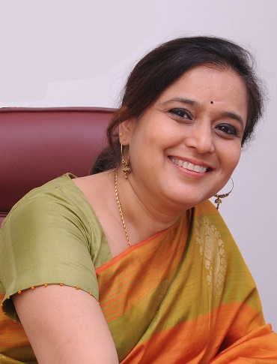
Director, Bangalore Fetal Medicine Centre & FGi Fetal Care Units Director, FGi-Research and training Institute Diploma in Fetal Medicine (FMF, UK) – 1st Indian Diploma in Advanced Obstetric Ultrasound (RCOG, UK)
Dr Prathima Radhakrishnan FRCOG
International posts
ISUOG Ambassador in India, 2021-23
Fellow representative, South Zone, AICC-RCOG
First to perform Therapeutic Fetoscopic LASER in India
First to start onsite and online distance learning blended courses in Fetal ultrasound benefitting several Drs across the country – www.fetalandgynaeimaging.com
SPECIAL INTEREST: Fetal diagnosis & Therapy; Fetal Screening strategies; Early fetal diagnosis
EDUCATIONALIST – Fellowships, Online & Onsite distance learning programs
Late Dr.Shirodkar Oration− “First Trimester Screening”, SOGS, Solapur, April 2021
Dr MV Parange Oration – “Reducing maternal & perinatal mortality – is it possible?”, AMOGS, Mahabaleshwar, Feb 2019
The First Trimester Anomaly scan – Keynote address at Hubli 2015, Mumbai 2018
Arnimaal Award – best presentation
Mohinder Kocchar award – best presentation
Performed successfully advanced fetal invasive procedures
Pioneered First trimester screening & Diagnosis in India
Several International, National and Regional presentations in FM over 16y
Role Models – Prof Kypros Nicolaides & Prof Lindsey Allan
FMF, UK accredited trainer for various certification courses by FMF

