Slide 1
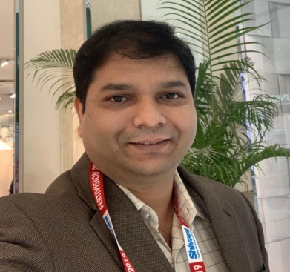
Dr. Nilaj Bagde
Additional Professor And Unit Head, AIIMS Raipur.
Ex-Faculty GMC Nagpur, MGIMS Sevagram, JNMC Wardha.
Ex-Research Fellow, MD Anderson Cancer Hospital, HOUSTON, Texas USA.
Ex-Secretary FOGSI (Deoli Sawangi) 2014-15.
Khandwala Best Paper Award –Gynecon 2015.
Publications : Author And Co-author Of Several Original Research Papers, Review, Case Reports In International And National Journals.
Faculty Lectures And Chairperson In Many National And State Conferences.
Clinical Secretary of Cardio Diabetic Society Of India.
Collaborator (Site PI) of international project “Clinical Phenotypes and Genetic Regulation of Endometriosis” funded by Wellcome Trust – DBT India-ICMR – (2019-2024).
In charge of speciality clinic on endometriosis at AIIMS Raipur

