Slide 1
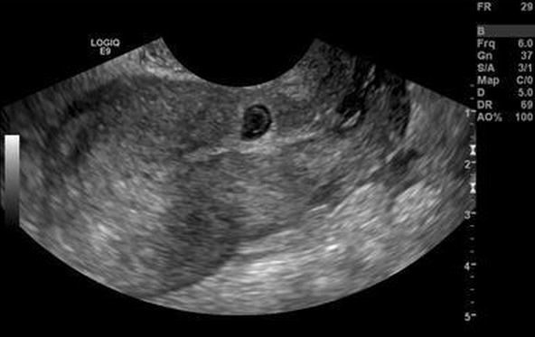
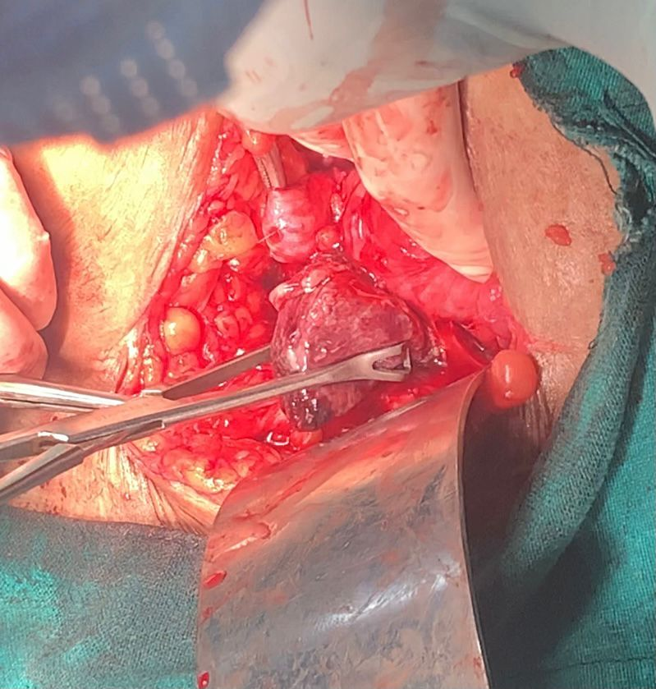
CESAREAN SCAR ECTOPIC PREGNANCY
-A DIAGNOSTIC CHALLENGE. DR.ERRABELLY NEETHA( MS OBG -PG) , UNDER GUIDANCE OF DR.M. VIJAYASREE PROF & HOD, MAMATA MEDICAL COLLEGE , KHAMMAM.
INTRODUCTION: Cesarean scar ectopic pregnancy is rare & occurs in approximately 1 in 200 pregnancies ^{1,2}.Globally,the incidence of primary cesarean section averages 18.6% of all births.³ There are 2 types of hysterotomy scar ectopic pregnancies. Type 1 develops in the myometrium & grows towards the uterine cavity,whereas type 2 progresses exophytically toward the uterine serosa.
DISSCUSION
Most cesarean scar pregnancies occured after 1 previous section . Hence number of c-sections appears to have no impact as on independent risk factors according to Jayaram PM et al., & according to Zhang et al.,early CSEP can be misdiagnosed as normal IUP, missed abortion , inevitable abortion or cervical pregnancy as in our case .
CASE REPORT:
A case of 26 year old G3P2L2 who had 2previous LSCS with 7 weeks GA with h/o intake of MTP kit on her own and came to our hospital with heavy bleeding not associated with clots. O/E- SPT scar , bleeding through os was present, uterus slightly bulky and no forniceal fullness and tenderness noted. Her hemoglobin was 8.9 g/dl. TAS showed gestational sac in the lower uterine segment.As there was no associated clots with bleeding in response to MTP kit , TVS was advised which revealed gestational sac in the lower uterine segment with irregular margins and visible yolk sac with thin myometrium suggestive of CSEP for which emergency laparotomy was done.Prophylactic bilateral uterine artery ligation done. A bluish swelling of size 4*5cm was noted on the uterine incision site and products were evacuated.Uterine closure was done with interrupted sutures.Tubectomy was done.1 unit of blood transfusion done and no other intra or postoperative complications occured.
CONCLUSION: Since cesearean section rate are increasing in the present day scenario ,high degree of suspicion of cesarean scar ectopic pregnancy aids in early diagnosis and treatment without undue complications.
REFERENCES
1.Elson CJ, Salim R, Potdar N, Chetty M, Ross JA, Kirk EJ. Diagnosis and management of ectopic pregnancy. BJOG: An International Journal of Obstetrics and Gynaecology. 2016;123(13):e15-55. 2.Jayaram PM, Okunoye GO, Konje J. Caesarean scar ectopic pregnancy: diagnostic challenges and management options. The Obstetrician & Gynaecologist. 2017 Jan;19(1):13-20. 3. Betrán AP, Ye J, Moller AB, Zhang J, Gülmezoglu AM, Torloni MR. The increasing trend in caesarean section rates: global, regional and national estimates: 1990-2014. PloS one. 2016 Feb 5;11(2):e0148343.

