Slide 1
Point of care blood clotting test and its correlation with fibrinogen level: Potential in goal directed transfusion in postpartum hemorrhage
Presented by- Dr. SANJITA PAL
Guided by- Dr. NALINI MISHRA, Dr. SUMA VELGIN EKKA

Slide 2
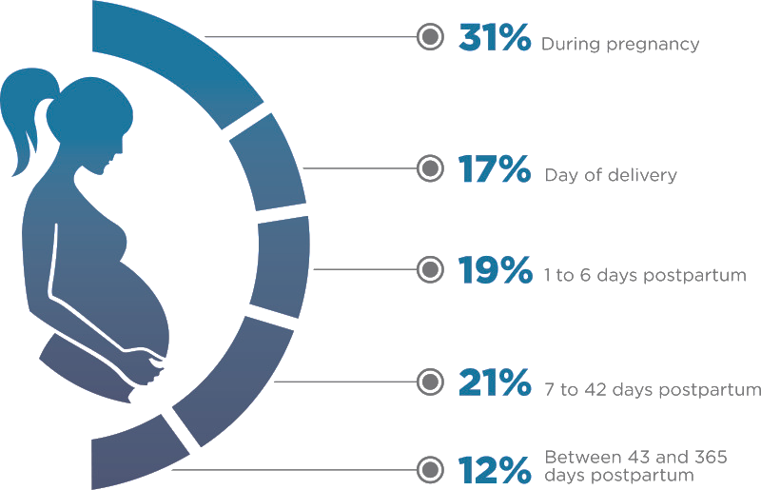
Introduction-
PPH is the major contributor to maternal mortality as well as morbidity. But this hemorrhage is different from adult non-obstetric major hemorrhages¹.
Atony of uterus and trauma are responsible for most (80%) cases and are amenable to early effective obstetric intervention without much lowering of fibrinogen¹.
However, if the bleeding continues unabated with overzealous fluid administration, dilutional coagulopathy develops with decreased fibrinogen.
Usual practice is to transfuse empirically (whole blood, FFP etc). However, as per recent recommendations fibrinogen replacement to be done, when fibrinogen level falls below 200 mg^{%2,3,4}.
Point of care testing like rotational thromboelastometry (ROTEM), correlates well with fibrinogen level and has short turn-around-time. However, its high cost and unavailability remains an important concern for low and middle income countries like us^{5,6,7}.
Point Of Care Clotting Time (POCCT) test of whole blood (without any additive) has been suggested to indicate coagulation failure if fails to clot within 5-10 minutes^{8,9}.

Slide 3
Aims and objectives-
Aim- To study the role of point of care clotting test & its correlation with fibrinogen level in women having primary major PPH and its comparison with those women in normal 3rd stage of labour in systematizing the transfusion of blood components & its effect on maternal outcome.
Primary objectives: Correlation of POCCT value and lab fibrinogen values in women having major PPH.
Secondary objectives:
Fibrinogen value in non PPH group
comparison of fibrinogen levels, HB%, platelet count, PT and INR amongst various subgroups of POCCT values
Mean volumes of blood loss, blood products transfused, second line(UBT) or surgical interventions to manage PPH, duration of admission to intensive care unit and mortality.

Slide 4
Materials and methods-
Sample size- 68
40 cases of PPH
(PPH group)
20 cases with normal 3rd stage of labour
(non PPH group)
8 samples of FFP
Exclusion criteria:
Women who have already received colloids or blood product transfusion
Ongoing anticoagulant therapy
Active liver disease
Centre- Department of Obstetrics & Gynaecology, Dr BRAMH, Raipur (C.G.)
Type of study- prospective observational cohort study
PPH was managed as per current guidelines.
Before starting any blood component, 20 mL blood was drawn for various tests including fibrinogen level determination and POCCT.

Slide 5
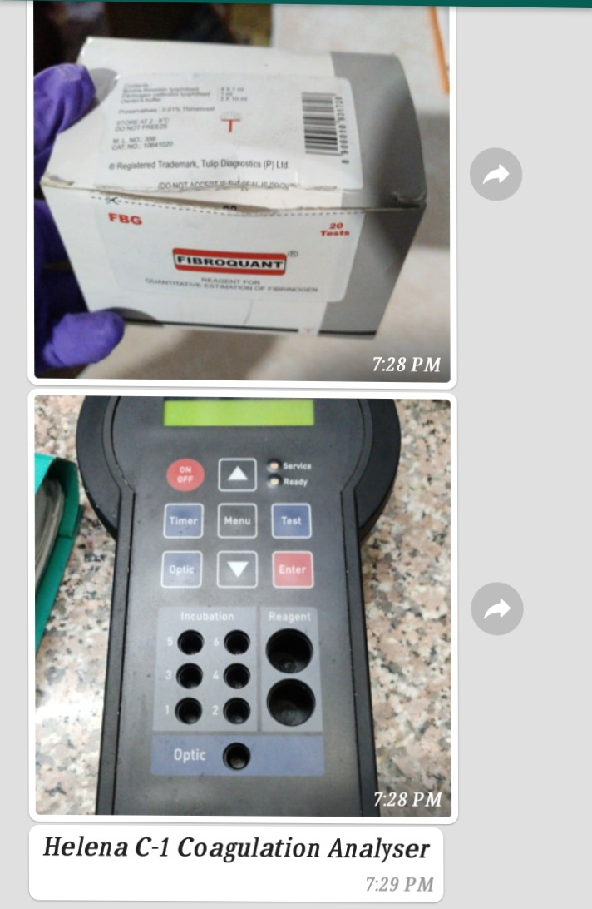
Methods-
Fibrinogen estimation:
Performed in the lab by
HELENA C1 COAGULATION ANALYSER
POCCT:
2 ml of whole blood taken in glass test tube. The tube was held in a closed fist to keep it warm.
After 4 min, the tube was tilted to observe whether a clot was forming.
It was then tilted every 30 sec until the blood clotted and the tube could be turned upside down.
If a solid clot failed to form by the end of 30 min, the test was not pursued further.

Slide 6
Comparative observation between PPH and Non PPH groups-
VARIABLES (Mean value) | PPH GROUP (n=40) | Non PPH GROUP (n=20) | P value
BIRTH WEIGHT | 2404.04 gms | 2670 gms | <0.11 (NS)
BLOOD LOSS | 1367.5 ml | 411 ml | <0.0001 (S)
POCCT | 611.75 sec | 313.5 sec | 0.0064 (S)
FIBRINOGEN | 346.15 mg% | 602.1 mg% | <0.0001 (S)
Pearson’s correlation coefficient | -0.69 | -0.29

Slide 7
Correlation of lab fibrinogen values of PPH group according to POCCT subgroups-
Variable | PPH Group (N=40)
 | Subgroup 1 POCCT < 7 min (N=15) | Subgroup 2 POCCT 7-11 min (N=18) | Subgroup 3 POCCT >11 min (N=7) | Total (N=40)
Fibrinogen level (mg%) (mean ) | 452.2 | 332.58 | 158.71 | 346.15
Pearson’s Correlation Coefficient(r) | -0.13 | -0.50 | -0.80 | -0.69
coefficient of determination (R²) | 0.016 | 0.25 | 0.63 | 0.48
p | < 0.65 | < 0.03 | <0.03 | <0.00001

Slide 8
Mean concentration of Fibrinogen in 3 different groups (in mg%)-
 | PPH group | Non PPH group | FFP
Fibrinogen conc (mg%) | 346.15 ± 143 | 602.1 ± 169.72 | 286.75 ± 103.42
Non PPH group
602.1 ± 169.72
PPH group
346.15 ± 143.37
FFP
286.75 ± 103.42

Slide 9
Discussion and conclusion-
The present study shows that-
POCCT values correlated well with Fibrinogen levels (Pearson’s correlation coefficient (r) -0.69, p = <.00001) and fell progressively as POCCT value increased.
POCCT may potentially be used to formulate protocols for targeted fibrinogen replacement if the more sophisticated POC test like ROTEM is not available.
This is a bedside test without costing anything and can identify the critical levels of fibrinogen corresponding to transfusion threshold values of fibrinogen at the given point of major PPH which is < 200 mg% and corresponds to POCCT of >11 minutes.

Slide 10
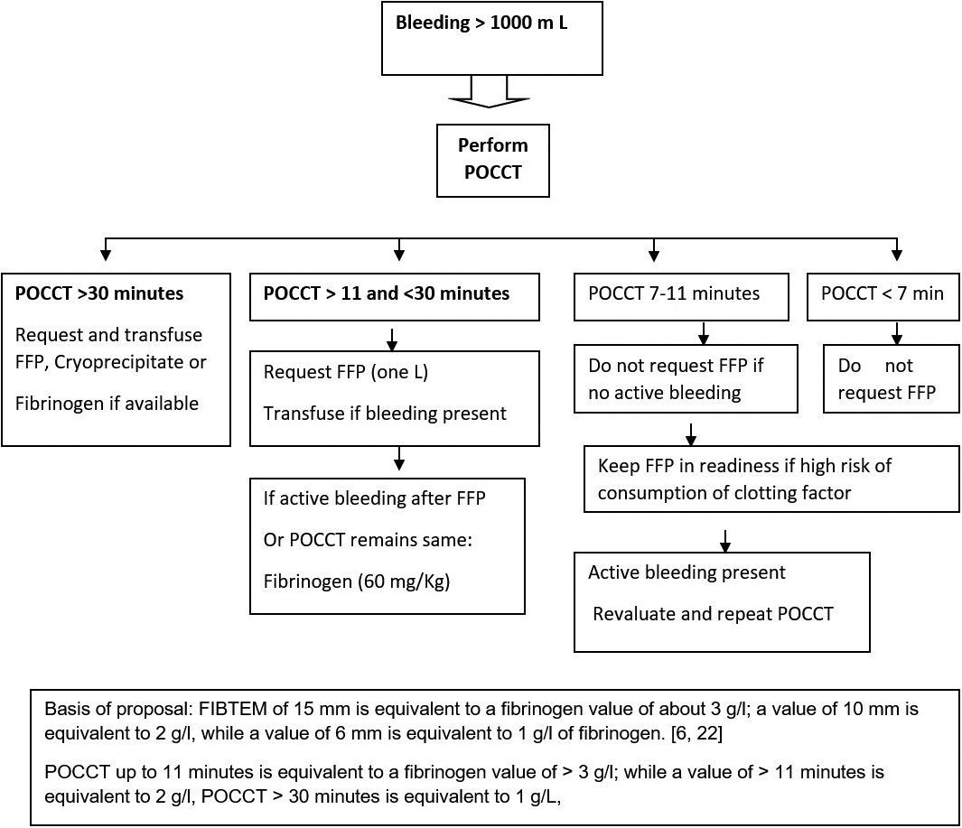
Proposed transfusion algorithm for fibrinogen supplementation based on fibrinogen equivalent of point of care clotting test values-
(by extrapolating the recommendations of fibrinogen replenishment based on the FIBTEM value as POC^{1,10,11,12})

Slide 11
Proposed transfusion algorithm^{1,10,11,12}-
T
H
A
N
K
Y
O
U
POCCT > 11 min
fibrinogen < 200 mg%
vigorous replenishment of clotting factors along with RBCs
POCCT >7 But < 11 min
fibrinogen > 200 mg%
POCCT < 7 min
fibrinogen > 400 mg%
Do Not request for FFP
withhold transfusion in case of arrest of hemorrhage.
high risk for consumptive coagulopathy,
worsening haemorrhage and POCCT
readiness for fibrinogen replacement in case of

Slide 12
References-
McNamara H, Mallaiah S. Managing coagulopathy following PPH. Best Practice & Research Clinical Obstetrics & Gynaecology. 2019;61:106-20.
Collins PW, Bell SF, De Lloyd L, Collis RE. Management of postpartum hemorrhage: from research into practice, a narrative review of the literature and the Cardiff experience. International journal of obstetric anesthesia. 2019 ;37:106-17.
Mavrides E, Allard S, Chandraharan E, Collins P, Green L, Hunt BJ, Riris S, Thomson AJ on behalf of the Royal College of Obstetricians and Gynaecologists. Prevention and management of postpartum hemorrhage. Green Top Guidelines no 52..BJOG 2016;124:e106–e149.
Klein AA, Arnold P, Bingham RM, Brohi K, Clark R, Collis R, Gill R, McSporran W, Moor P, Rao Baikady R, Richards T. AAGBI guidelines: the use of blood components and their alternatives 2016. Anaesthesia. 2016 ;71:829e-42.
McNamara H, Kenyon C, Smith R, Mallaiah S, Barclay P. Four years' experience of a ROTEM®‐guided algorithm for treatment of coagulopathy in obstetric hemorrhage. Anaesthesia. 2019;74(8):961-4
Peng HT, Nascimento B, Beckett A. Thromboelastography and thromboelastometry in assessment of fibrinogen deficiency and prediction for transfusion requirement: a descriptive review. BioMed Research International. 2018;11:1-24
Mallaiah S, Barclay P, Harrod I, Chevannes C, Bhalla A. Introduction of an algorithm for ROTEM‐guided fibrinogen concentrate administration in major obstetric hemorrhage. Anaesthesia. 2015 ;70(2):166-75.
POPPHI. Prevention of Postpartum Hemorrhage: Implementing Active Management of the Third Stage of Labor (AMTSL): A Reference Manual for Health Care Providers. Seattle: PATH; 2007.
Evensen A, Anderson J M, Fontaine P. Am Fam Physician. 017; 95 (7):442-9.
Guasch E, Gilsanz F. Massive obstetric hemorrhage: current approach to management. Med Intensiva. 2016;40(5):298-310.
Collins PW, Lilley G, Bruynseels D, et al. Fibrin-based clot formation as an early and rapid biomarker for progression of postpartum hemorrhage: a prospective study. Blood. 2014;124(11):1727-1736.
Collis RE, Collins PW. Haemostatic management of obstetric hemorrhage. Anaesthesia. 2015;70:78-86.
THANK YOU

