Slide 1


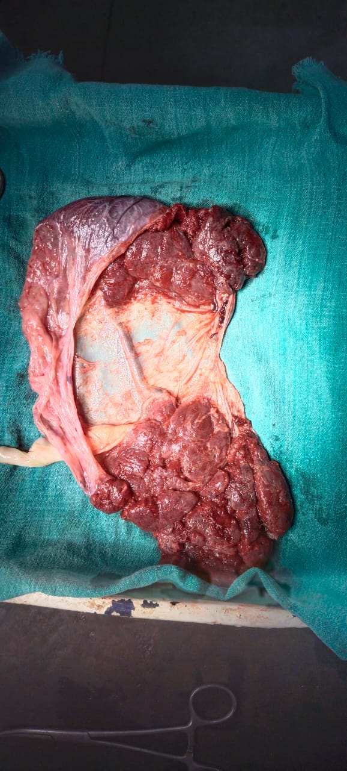
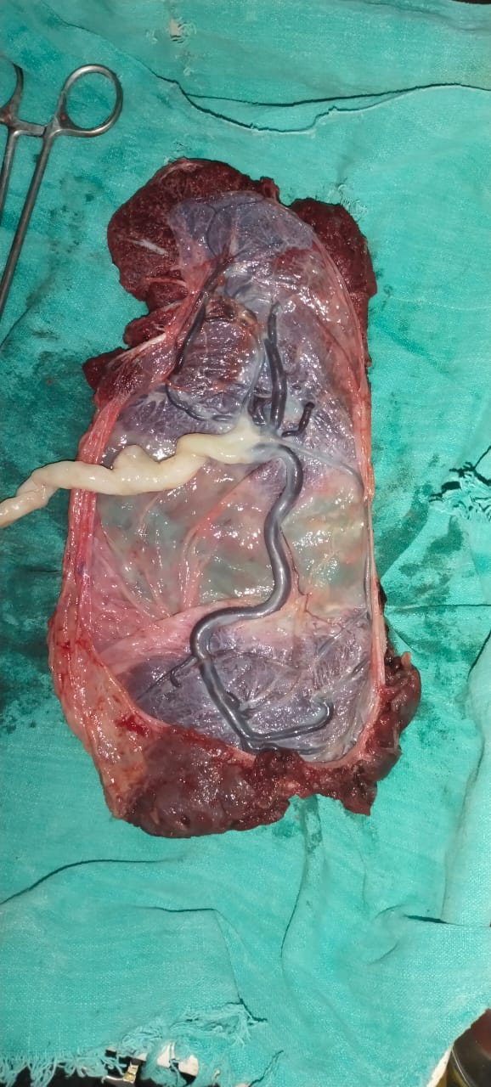
BILOBATE PLACENTA – AN INCIDENTAL FINDING: CASE REPORT
Dr. Shweta Yadav, Dr. Ruchi Gupta, Dr. Anjum Khan, Dr. Neelam Singh, Dr. Pratibha Lambodari
INTRODUCTION- Bilobate placenta is an abnormality of placenta having two roughly equal sized lobes separated by a membrane. The umbilical cord insertion is in either lobe, in velamentous fashion, or in between the lobes. No fetal anomalies have been associated with it, though it can result in first trimester bleeding, polyhydromnios, abruption, or retained placenta.
CASE- 24-year-old G2P1L1 term pregnancy came with complaint of Antepartum hemorrhage with lower abdominal pain since 4-5 hours, with history of passage of clots per vagina. She had 1 previous vaginal delivery. She had one ultrasound report documenting- SLIUF, of 32 weeks, cephalic presentation, adequate AFI, placenta was anterior in upper segment of uterus with grade 1 maturity. No other specific findings mentioned in ultrasound report.
On per abdomen examination: 34-36 weeks sized uterus, relaxed, longitudinal lie Cephalic, Head floating, EBW -1.8-2 kg, FHS -146 bpm.
Per speculum examination: Os closed, Bleeding per vaginally seen.
Per vaginal examination: Os closed, boggy mass felt, soft in consistancy.
Immediately caesarean section has been done in view of antepartum hemorrhage with ? placenta previa ? Abruption.
INTRAOPERATIVE FINDINGS- A healthy male baby of 2 kg delivered out by vertex. 1 lobe of placenta found in upper uterine segment and 2nd lobe found in lower uterine segment completely covering the Os. Both lobes removed completely along with their membranes.
DISCUSSION- The detection of bilobate placenta is very important in the antenatal period by ultrasonography. The vessels connecting the main placenta with the second lobe may rupture during labor and lead to fetal demise, it may also lead to maternal complications. Accompanying vasa praevia may cause dangerous fetal hemorrhage at delivery.
CONCLUSSION- This case is atypical presentation of placental abnormality which was undiagnosed in USG evaluation while identified during clinical examination which establishes the significance of clinical judgment.
REFERENCES-
Rathbun KM, Hildebrand JP. Placenta Abnormalities. In: StatPearls [Internet]. Treasure Island (FL): StatPearls Publishing; 2021 Jan
Ziadie MS. Accessory lobe / bilobate placenta. PathologyOutlines.com. Accessed September 7th, 2021

