Slide 1



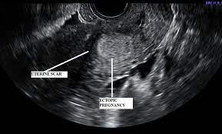
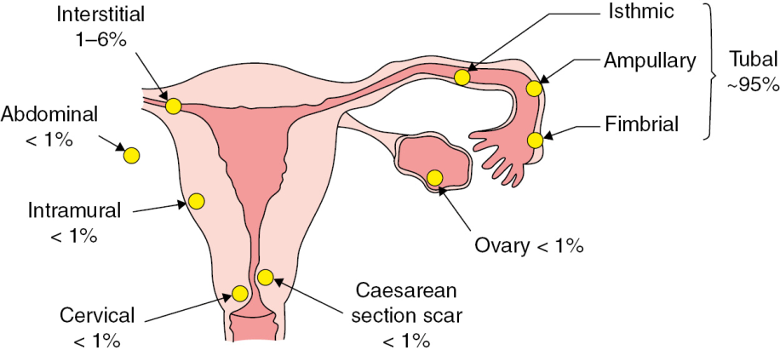
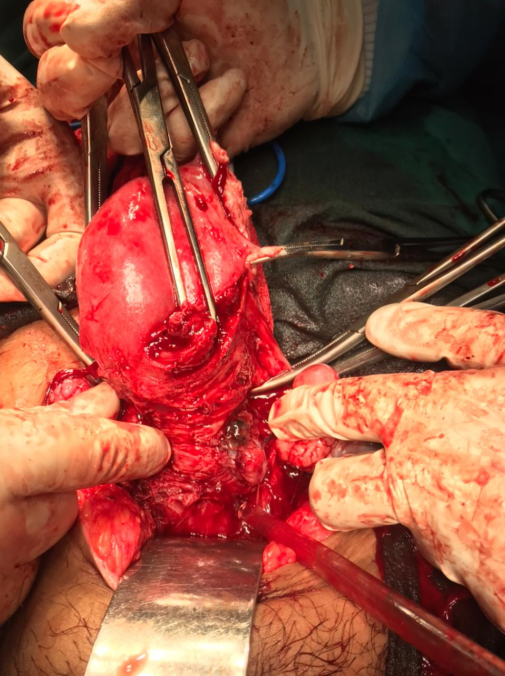
A missed caesarean scar ectopic pregnancy may land up in hysterectomy: a case report
Dr Sanjita Pal, Dr Ruchi Kishore, Dr Pratibha Lambodari, Dr Neelam Singh, Dr Anjum Khan
DEPARTMENT OF OBSTETRICS & GYNAECOLOGY,DR.BRAMH RAIPUR,CHHATTISGARH
INTRODUCTION:
A caesarean scar pregnancy (CSP) is a complex iatrogenic pathology, which represents a consequence of a previous caesarean section.
Total incidence of ectopic pregnancy is 0.5-1.5%. Most common location of ectopic pregnancy is fallopian tube (>95%). Besides this, other rare locations are- Interstitial (≈2%), and rare sites include- abdominal, ovarian, cervical and cesarean scar (all constituting upto only <5% of all ectopic sites)¹. CSP have a prevalence of 1 in 2000 pregnancies.
It has had an exponential increase in recent years due to parallel increase in number of the caesarean sections.
Here, we report a case of CSP that, following an initial apparently successful treatment, required surgical management due to heavy bleeding. Therefore, CSP has to be evaluated
during the first
trimester.
CASE REPORT :
A 40 year old
G4P2L2Ab1 with previous 2 cesarean sections with 1½ months amenorrhoea & spotting for last 15 days followed by lower abdominal pain & bleeding PV since 3 day at the time of admission leading to diagnosis of threatened abortion, which was confirmed on USG & managed conservatively. But, after one week she had heavy and profuse bleeding along with lower abdominal pain and hemodynamic instability, for which she was immediately taken for evacuation in Ot under USG guidance which revealed the suction cannula inside an empty uterine cavity and sac seen separately in lower uterine segment near caesarean scar site.
P/V Examination- dark coloured bleeding seen.
TVS in OT-
A gestational sac at the lower uterine segment with no cardiac activity & empty uterine cavity, both adnexa were normal, possibly a scar pregnancy.
As patient was having excessive bleeding PV and gestational sac was seen outside the uterine cavity, so possibility of ruptured scar pregnancy was kept & emergency laparotomy was done.
Intraoperative findings-
On uterine incision, gestational sac and products of conception was found attached to scar site which was invading lateral wall upto uterine artery, so total hysterectomy was done in view of profuse bleeding.
Two units of packed red blood cells was transfused intra-operatively.
Post operative period was uneventful.
DISCUSSION:
Ectopic pregnancy refers to implantation of embryo outside the uterus.
CSP has two types. Type 1 in which the implant is growing inwards with potential to get converted to viable fetus but with high risk of invasive placenta and severe bleeding, and the second type is growing towards the serosa with high risk of rupture in early pregnancy².
Gold standard is TVS USG criteria for scar ectopic pregnancy- Empty uterus, empty endocervical canal, thin or absent layer of myometrium between gestational sac and urinary bladder, gestational sac or trophoblast sited anteriorly, at the level of internal os, or lower uterine segment at the site of previous hysterectomy scar. Evidence of trophoblastic/ placental blood flow on doppler.
The differential diagnosis includes threatened abortion, incomplete abortion, cervical pregnancy, malignant trophoblastic tumour.
A CSP may present as a threatened miscarriage, or remain asymptomatic through the first trimester. Medical treatment may be successful, however may need surgical management or hysterectomy as life saving procedure as in this case.
Management: Expectant- medical management with methotrexate, uterine artery embolization. Surgical management: Evacuation by Dilatation & Curettage, hysteroscopic resection, excision of pregnancy by laparotomy or laparoscopy or transvaginally , hysterectomy.
References:
Cunningham, F. G., Leveno, K. J., Bloom, S. L., Dashe, J. S., Hoffman, B. L., . . . Spong, C. Y. (2018). Williams obstetrics (25th edition.). New York: McGraw-Hill Education.
2. Abadilla AM, Jaspan D, Dandolu V. Scar pregnancy: a rare complication of caesarean section. Gynecological Surgery. 2008 Sep;5(3):253-5.

