Slide 1
“YOU ONLY LIVE TWICE.”
A Case Series on
Placenta Accreta Spectrum
THEME: Haemorrhage in pregnancy
Dr. Shristy Mohanty
PG Resident
IMS & SUM Hospital.

Slide 2
INTRODUCTION
Placenta accreta spectrum, formerly known as “Morbidly adherent placenta” refers to the range of pathologic adherence of the placenta including placenta increta, percreta and accreta.
Ranges from abnormally adherent to deeply invasive placental tissue.
ACOG defines - as abnormal trophoblast invasion of part or all of the placenta into the myometrium of the uterine wall.

Slide 3
INTRODUCTION
The risk factors are history of accreta in a previous pregnancy, previous caesarean delivery and other uterine surgery, repeated endometrial curettage.
This risk rises as the number of prior caesarean sections increases.
It is associated with substantial morbidity, with the majority of women requiring blood transfusion, unanticipated surgery, and admission to the ICU.

Slide 4
MATERIALS & METHODS
Type of study: Retrospective observational study
Duration of study: 18 months
IMS and SUM Hospital, Bhubaneswar
Patient selection: Pregnant patients admitted in the OPD and Labour Room who were diagnosed with central/ anterior placenta praevia in a previously scarred uterus.

Slide 5
Patient No. | Age (years) | Obs. Index | Previous uterine surgery | Presenting complaint
1 | 40 | G3P2L1 | Previous 2 LSCS | For confinement
2 | 26 | G3P2L2 | Previous 2 LSCS | For confinement
3 | 28 | G3P2L1 | Previous 2 LSCS | Bleeding p/v
4 | 34 | G3P2L2 | Previous 2 LSCS | Bleeding p/v
5 | 34 | G3P2L2 | Previous 2 LSCS | Bleeding p/v
6 | 32 | G2P1L1 | Previous 1 LSCS | Bleeding p/v
7 | 30 | G2P1L1 | Previous 1 LSCS
8 | 28 | P3L2A4 | Previous 1 LSCS Induced abortion- S & E 1 month back | Bleeding p/v
9 | 25 | G2P1L1 | Previous 1 LSCS | Leaking p/v

Slide 6
Patient No. | CS | Surgical complications | ICU admission | Pre op Hb | Post op Hb | Transfusions given | Outcome
1 | Elective | Hysterectomy Bladder injured | No | 11.1 | 5.6 | 3 PRBCs | Recovered
2 | Elective | Hysterectomy | No | 10.8 | 5.2 | 4 PRBCs | Recovered
3 | Emergency | Hysterectomy Bladder injured. | Yes | 10.2 | 2.3 | 10 PRBCs, 16 FFPs, 6RDPs | DIC, Died
4 | Emergency | Hysterectomy | Yes | 9.6 | 3.4 | 4 PRBCs | Recovered
5 | Emergency | Hysterectomy | Yes | 10.6 | 4.9 | 4PRBCs | Recovered
6 | Emergency | Hysterectomy Bladder injured | Yes | 8.1 | 2.0 | 6 PRBCs | Recovered
7 | Elective | Hysterectomy | Yes | 11.3 | 3.2 | 4 PRBCs, 12 FFPs, 6 RDPs | Sepsis, readmission to ICU, recovered.
8 | Elective | Hysterectomy | No | 9.6 | 8.0 | - | Recovered
9 | Emergency | Hysterectomy Bladder serosal layer injured. | Yes | 10.3 | 7.4 9 | 4 PRBCs, 4 FFP | Sepsis, Recovered.

Slide 7
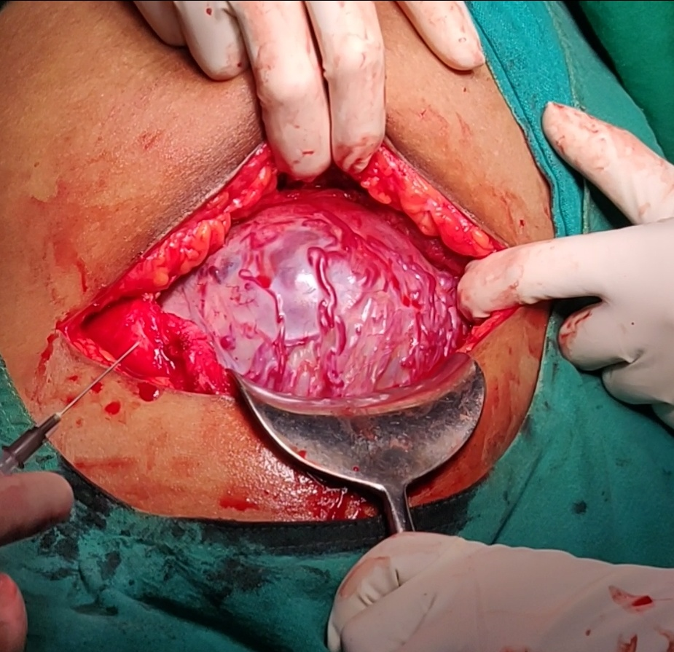
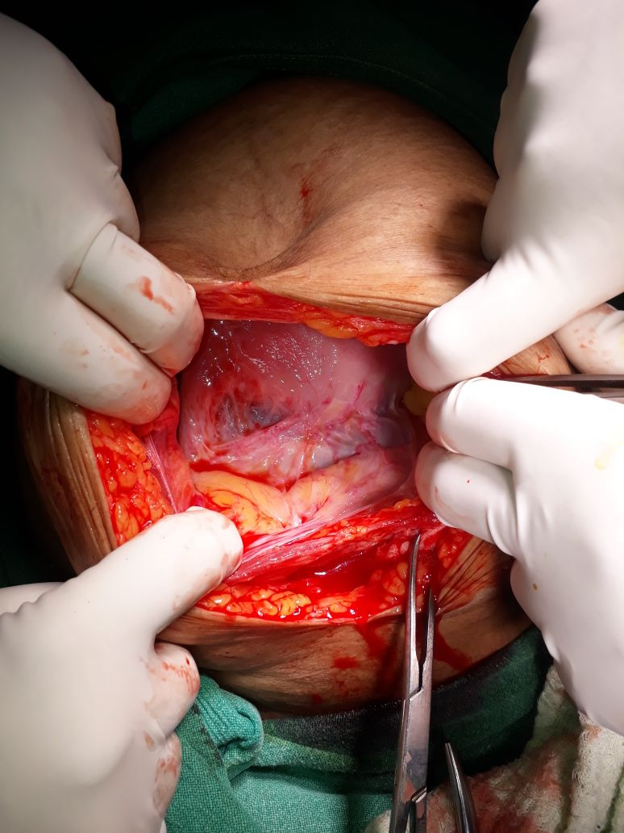
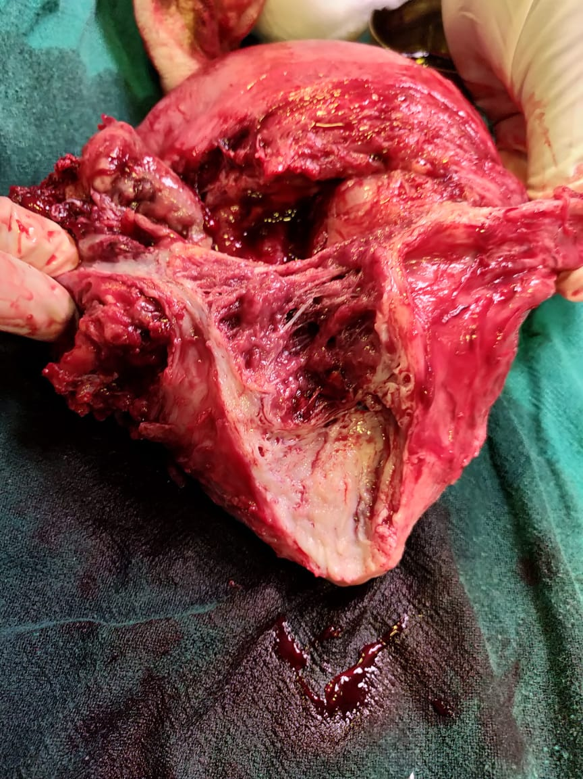
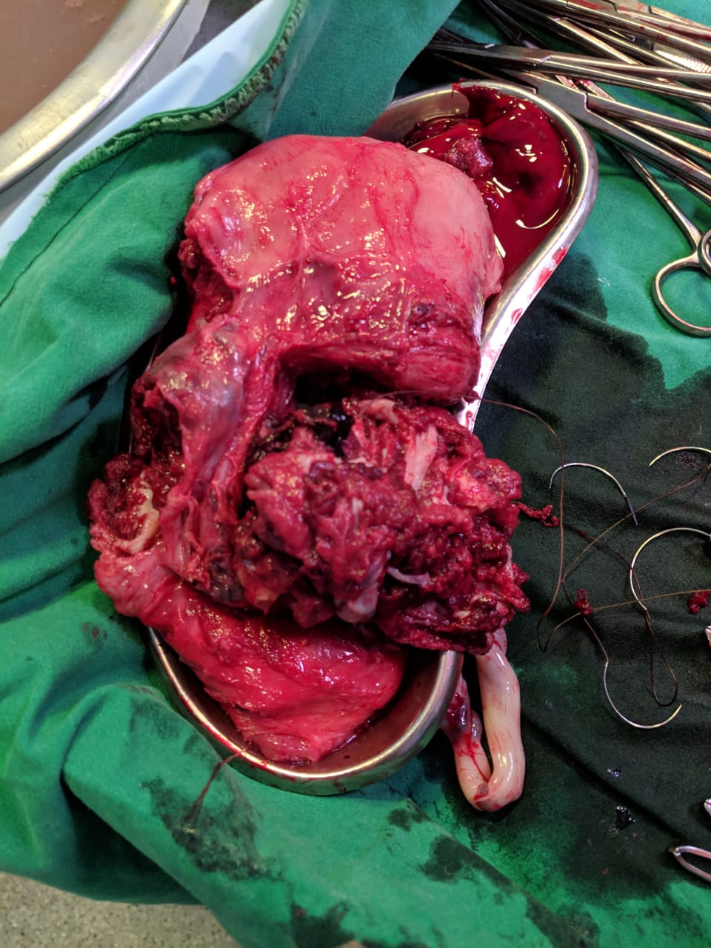
Case 2
Case 6
Case 7
Case 4

Slide 8
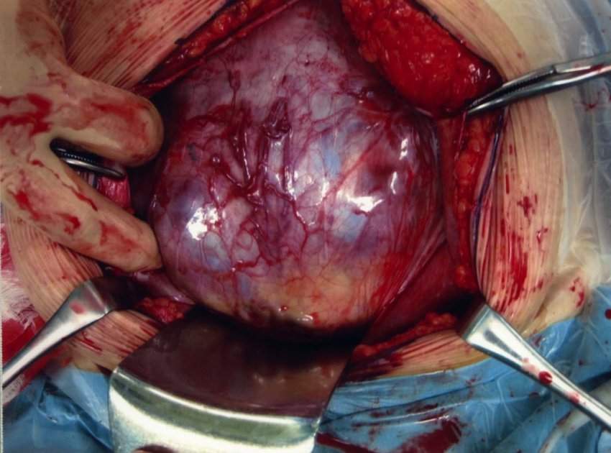
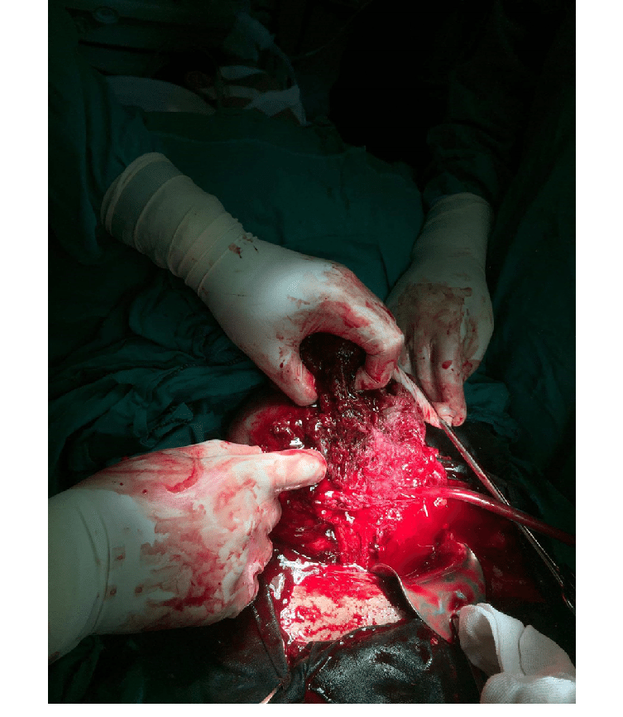
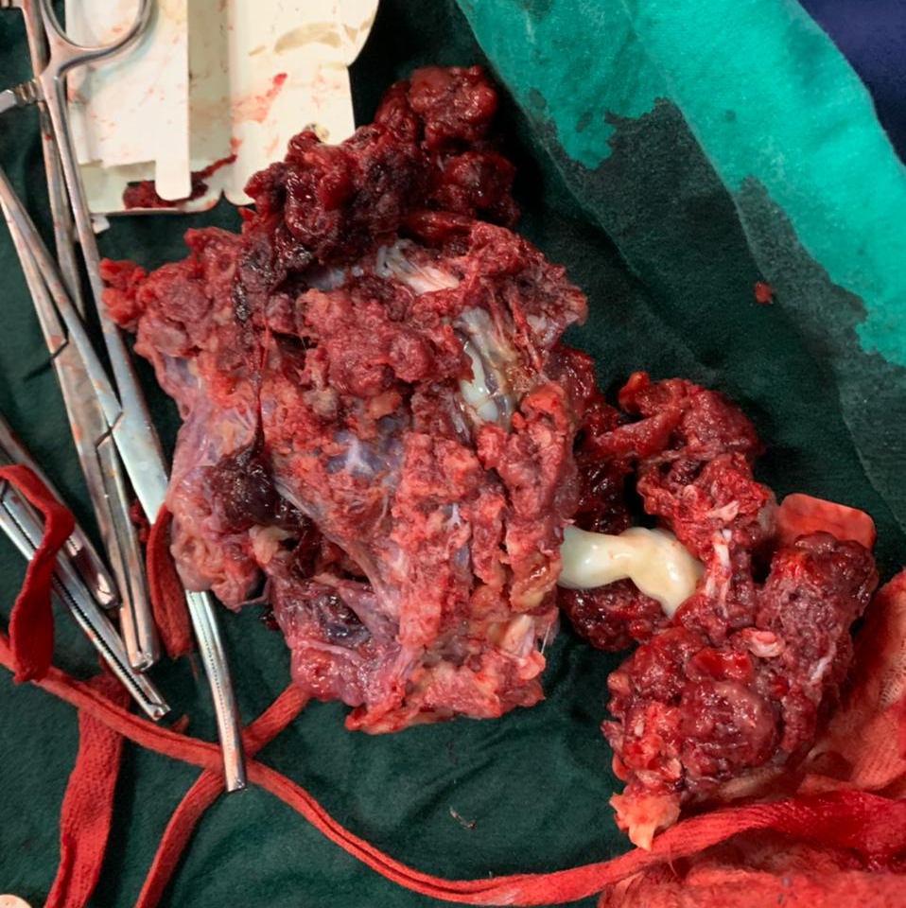
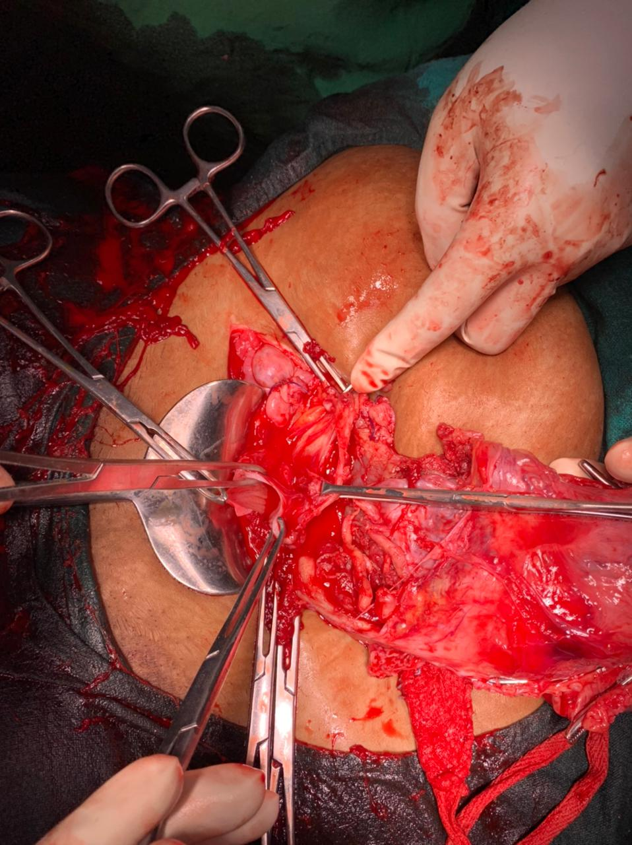
CASE 9

Slide 9
SCAR ECTOPIC WITH INCRETA, PERCRETA-
A Diagnostic Dilemma
Case no. 8 was pre-operatively diagnosed as Cervical pregnancy.
On laparotomy, a bluish mass 9 x 4 cm was seen over the lower segment extending towards the cervix.
Previous caesarean scar was completely eroded by the mass.
Cut-section showed a bluish-black coloured organised mass arising from lower uterine segment and extending into the cervix.
Provisional diagnosis: Caesarean Scar Ectopic Pregnancy
HP report- Features compatible with placenta increta with focal evidence of placenta percreta involving uterine body with extension into lower uterine segment and cervix.
Final diagnosis: P3 L2 A4 with caesarean scar ectopic pregnancy with placenta increta and percreta.

Slide 10
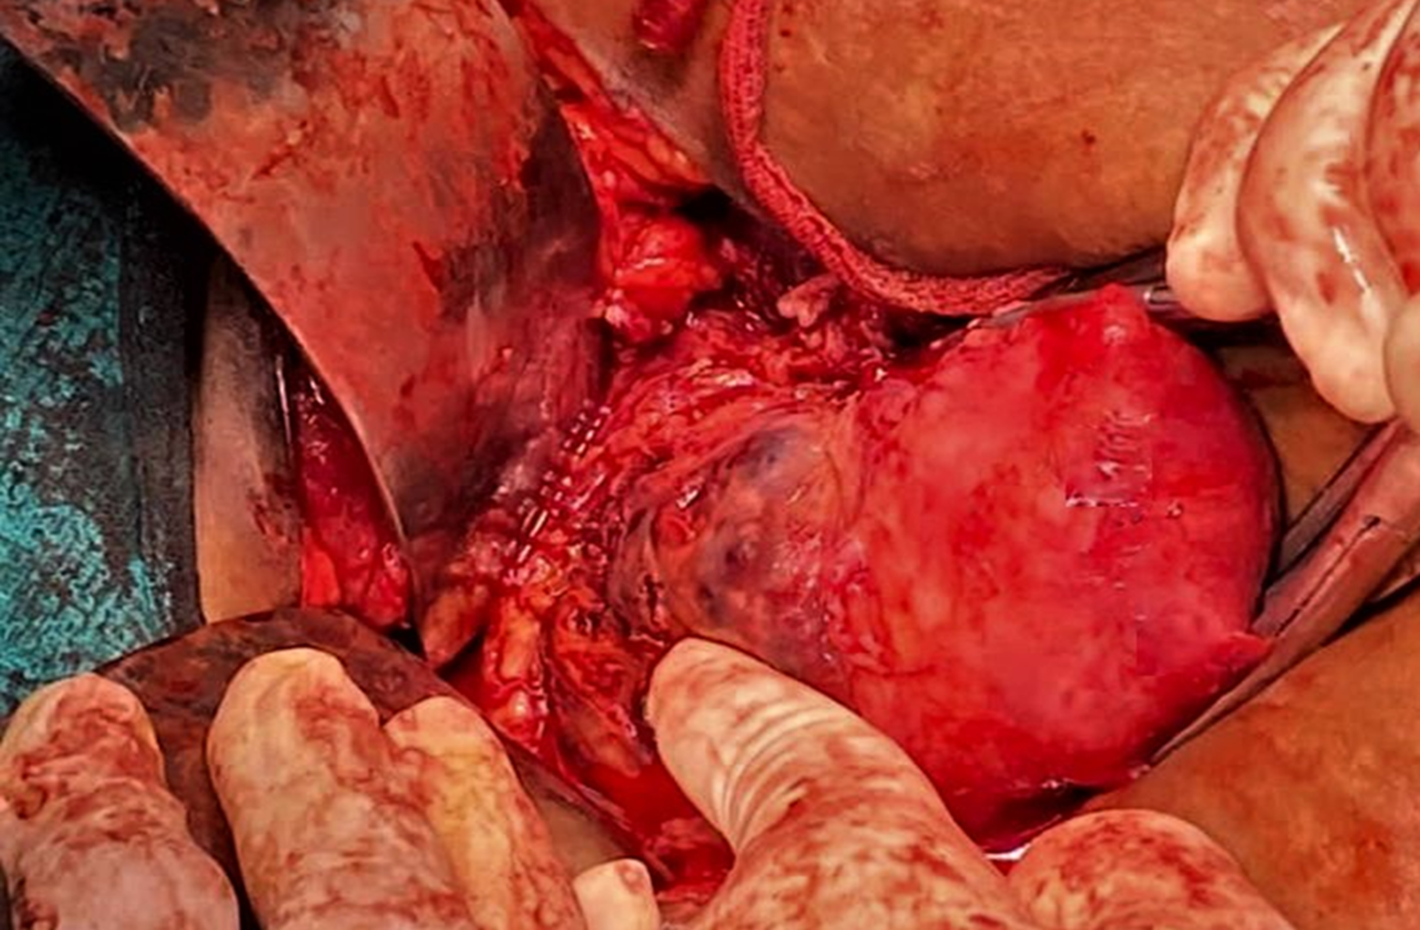
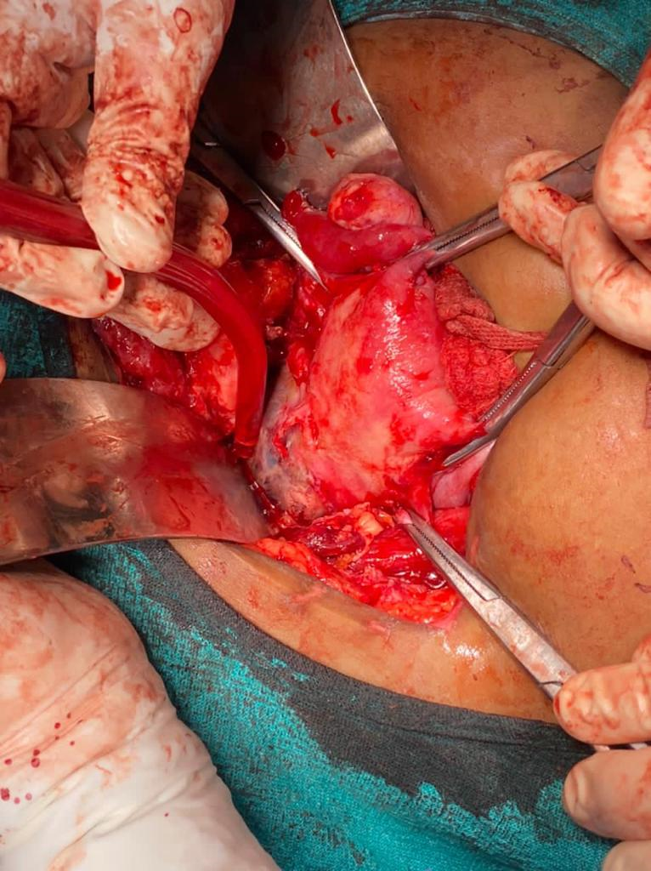
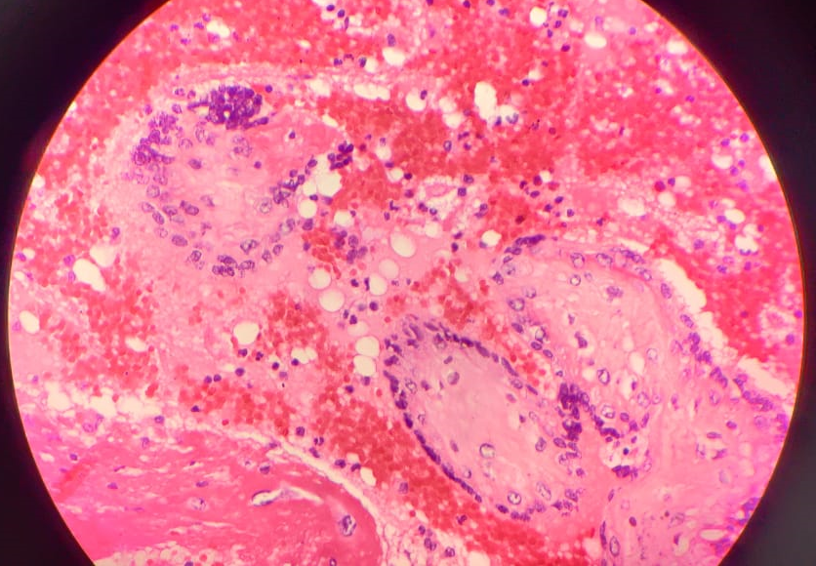
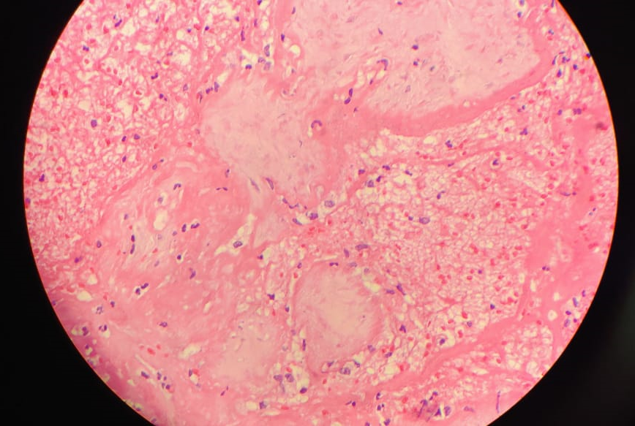
CASE 8

Slide 11
DISCUSSION
5 patients had H/O previous 2 LSCS. Rest had 1 LSCS.
3 patients underwent elective caesarean section near term after antenatal diagnosis of placenta accreta, increta. Other 5 were diagnosed intraoperatively.

Slide 12
DISCUSSION
100% of the patients underwent total hysterectomy.
4 patients had bladder injury during hysterectomy, requiring prolonged catheterisation.
6 patients needed ICU care post operatively.
8 out of the 9 patients required multiple blood transfusions.
8 patients recovered, one patient died after developing DIC.

Slide 13
Women requesting elective caesarean delivery for non‐medical indications should be informed of the risk of placenta accreta spectrum and its consequences for subsequent pregnancies.
CLINICAL SUSPICION of placenta accreta spectrum in previous LSCS in the presence of an anterior low‐lying placenta or placenta praevia.
These women, at the routine foetal anomaly scan should be specifically screened for placenta accreta spectrum.
Delivery should take place in a specialist centre with logistic support for immediate access to blood products, adult ICU and NICU - a multidisciplinary team approach.

Slide 14
In the absence of risk factors for preterm delivery in women with placenta accreta spectrum, planned delivery at 35⁺⁰ to 36⁺⁶ weeks of gestation provides the best balance between fetal maturity and the risk of unscheduled delivery.
Counsel for specific risks in terms of massive haemorrhage, increased risk of lower urinary tract damage, need for blood transfusion and hysterectomy.

Slide 15
CONCLUSION
Women with previous uterine surgery who now have placenta previa should be evaluated for placenta accreta and managed as if they have placenta accreta.
Diagnosis is usually established by ultrasonography. MRI and cystoscopy may be indicated to evaluate the extent of placental invasion.
Placenta praevia is a life threatening condition. Proactive measures to reduce the number of caesarean sections will help reduce the incidence of placenta praevia and accreta.
Diagnosis of placenta accreta before delivery allows multidisciplinary planning in an attempt to minimize potential maternal and neonatal morbidity and mortality.

Slide 16
REFERENCES
Miller DA, Chollet JA, Goodwin TM. Clinical risk factors for placenta previa-placenta accreta. Am J Obstet Gynecol 1997; 177:210.
RCOG 2018
Obstet Gynecol. 2018 Dec;132(6):e259-e275. doi: 10.1097/AOG.0000000000002983
Stocker J, Dehner L. Pediatric Pathology VolumeOne Lippincott Williams and Wilkin. USA; 2001.
Shnider S, Levinson G. Anaesthesia for Obstetrics 3rd Edition Williams and Wilkins. USA; 1993.
Gielchinsky Y, Rojansky N, Fasouliotis S. Placenta Accreta - Summary of 10 Years: A Survey of 310 Cases Placenta. 2002;23:210‐4.

Slide 17
Thank You

