Slide 1
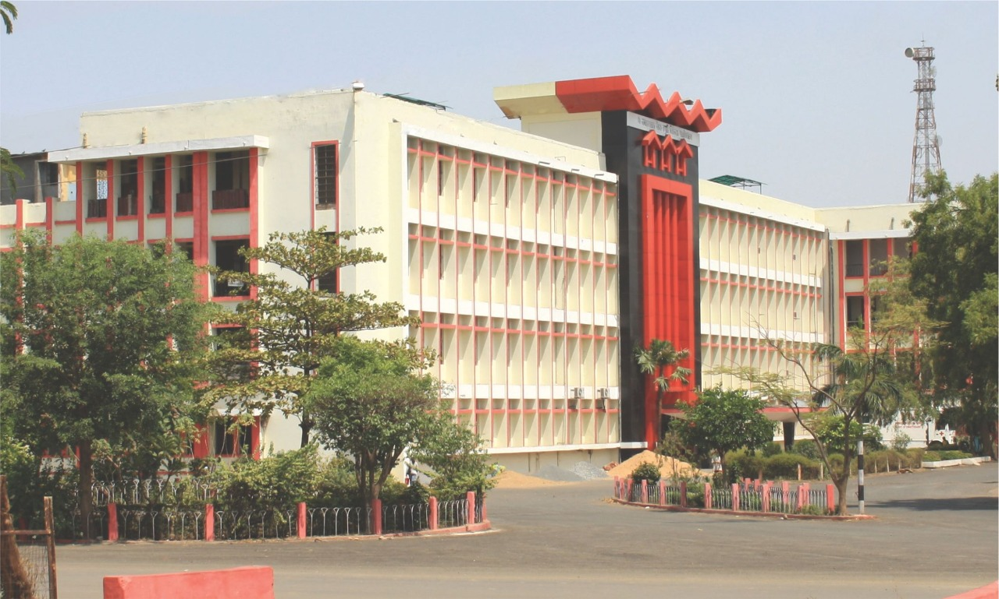
Neglected and persistent vomiting of pregnancy: Can it be malignancy?
Pt Jawahar Lal Nehru Memorial Medical College And Dr Bhim Rao Ambedkar Memorial Hospital, Raipur (Chhattisgarh)
Presentor
Dr Anshu Agrawal
3rd year resident
Dept. of OBGY
Guide
Dr Jyoti Jaiswal
Dr Smrity Naik
Dr Shweta Singh Dhruw

Slide 2
Introduction
Nausea and vomiting is a common entity of pregnancy. 7 out of 10 women experience some level of NVP.
It starts and ends in 1st trimester in most of the cases. Women who experience vomiting even up to 3rd trimester should raise a suspicion.
Causes of 3rd trimester vomiting -cholecystitis, gastroenteritis, GERD, pre-eclampsia/HELLP, drug induced vomiting, peptic ulcer etc. Gastric carcinoma is one of the rarest cause.
Pregnancy associated gastric cancer is defined as diagnosis of gastric cancer during pregnancy or within 1 year of delivery. Gastric cancer with pregnancy in one of very rare finding complicating 0.026-0.1% of all pregnancies worldwide.
Often diagnosed very late and in advance stages by the treating health facility due to negligence and overlapping of symptoms

Slide 3
Risk factors for gastric carcinoma include sex(male>female), age(more common after 45yrs), smoking, ethnicity and geography (Eastern Asia), history of gastric ulcer, helicobacter pylori infection, immunosuppressive conditions.
The clinical presentation of gastric carcinoma like vomiting, dyspepsia, hematemesis, melena, weight loss may be confused with similar presentations in pregnancy.
A strong suspicion should be raised in non responding cases. Gastric cancer during pregnancy has got poor outcome.
I hereby present a very interesting case of gastric carcinoma which was diagnosed in 3rd trimester.

Slide 4
Case report
A 25year primigravida at 34 weeks of gestation presented to our hospital with severe IUGR. She was already booked in other hospital.
She complained of vomiting and gave history of continuous nausea and vomiting which was initially mild. Over passage of time she was unable to tolerate solid food. It was so severe that she was on liquid diet only and also gave history of weight loss.
General examination: - Thin built, brittle discolored rough hairs with cracked lips and angular cheilosis. Her GC was average, BP normal, Pulse 98bpm,mild pallor present, edema absent.
Per abdomen : 24-26weeks uterine size, relaxed, clinically liquor less, FHS 132bpm, EBW 1-1.2kg.

Slide 5
Her investigations(CBC, RFT , S. Electrolyte, TSH ,Urine routine and microscopy) were normal except mildly elevated liver enzymes.
Treatment started for Nutritional deficiency and IUGR.
For vomiting inj. Ondansetron 4mg 8hourly,inj. Metoclopramide 10mg 12hourly, tablet Doxylamine and syrup sucralfate 2tsf TDS was started but no response was seen.
She was further investigated for persistent and non responding vomiting with consultation from physician and surgeon.

Slide 6
USG whole abdomen showed thickening of stomach wall.
MRI – asymmetrical circumferential thickening of antropyloric region of stomach.
Endoscopy and biopsy-showed diffuse infiltrative adenocarcinoma (signet ring cell).
Dilemmas were many like maternal and foetal outcome (severe IUGR and very low birth weight), continuation or termination of pregnancy and last but not least the mode of delivery with the growing tumour.

Slide 7
As patient was already 35weeks + , she was planned for termination of pregnancy but she went into spontaneous labour.
She went into spontaneous preterm labour and delivered vaginally 1.3kg with APGAR score of 7/8. Baby was discharged after 35days.
Diagnosed as stage II CA Antrum (T2N2M0).
After delivery she was registered for chemotherapy with Onco-surgery and Radiotherapy dept. consultations.
She received 3 cycles of neo-adjuvant chemotherapy [oxaliplatin85mg + docetaxel50mg+ capecitabine500mg] and was given filgrastim(rHu-CSF)]

Slide 8
Had undergone surgery - distal subtotal gastrectomy with D2 lymph node dissection.
HPE- 6*3.5*2.5cm growth in distal stomach reaching upto serosa (signet ring cell adenocarcinoma 0/5 nodes)
At present she is receiving radio therapy, completed 2 cycles and now tolerating semisolid diet well.

Slide 9
Discussion
NVP in 1st trimester is because of raised level of beta HCG especially in primigravida. It may extend up to 20weeks in some cases.
Nausea-vomiting continuing till 3rd trimester along with weight loss should raise suspicion of abnormalities.
Apart from USG and MRI, endoscopic screening should be advised as it is low risk procedure in pregnancy with least maternal and foetal effects.
Gastric cancer have got poor prognosis in female when compared to men of same age group and poorer in young population.

Slide 10
5year survival in young females diagnosed with gastric cancer during pregnancy greatly vary according to staging at the time of diagnosis as well as on type of cancer cells.
Treatment of Gastric carcinoma associated with pregnancy is same as that of gastric carcinoma in any other patient. However it may affect foetal outcome but that should not delay the onset of treatment.
This case needs to be reported as the women herself and HCW kept on neglecting symptom's considering it to be hyperemesis gravidarum.
With our determination to investigate she was diagnosed as CA Antrum stage II and soon had preterm vaginal delivery.

Slide 11
Conclusion
Awareness, a hope of future, to diagnose and cure.
Severe, persistent and non responsive NVP associated with weight loss should be investigated vigilantly and thoroughly.
One of rarest cause i.e. gastric carcinoma should
not be missed.
Diagnosis in early stage and management can have better prognosis and prolong the life expectancy of women to let her enjoy greatest happiness of motherhood.

Slide 12
References
Cift, T., Aydogan, B., Akbas, M., Aydin, B., Demirkiran, F., Bakkaloglu, D. V., & ILvan, S. (2011). Case Report: Gastric Carcinoma Diagnosed at the Second Trimester of Pregnancy. Case Reports in Obstetrics and Gynecology, 2011, 3pages.
Pacheco, S., Norero, E., Canales, C., Martinez, J. M., Herrera, M. E., Munoz, C., & Jarufe, N. (2016). The Rare and Challenging Presentation of Gastric Cancer during Pregnancy: A Report of Three Cases. J Gastric Cancer, 16(4), 271-275.
Yildiz, M., Akgun, Y., Ozer, H., & Mihmanli, V. (2020). A rare case presentation: pregnancy and gastric carcinoma . BMC Gastroenterology, 1-3.
Yoshida, M., Matsuda, H., & Furuya, K. (2009). Successful Treatment Of Gastric Cancer In Pregnancy. Taiwan J Obstet Gynecol, 48, 282-285.

