Slide 1
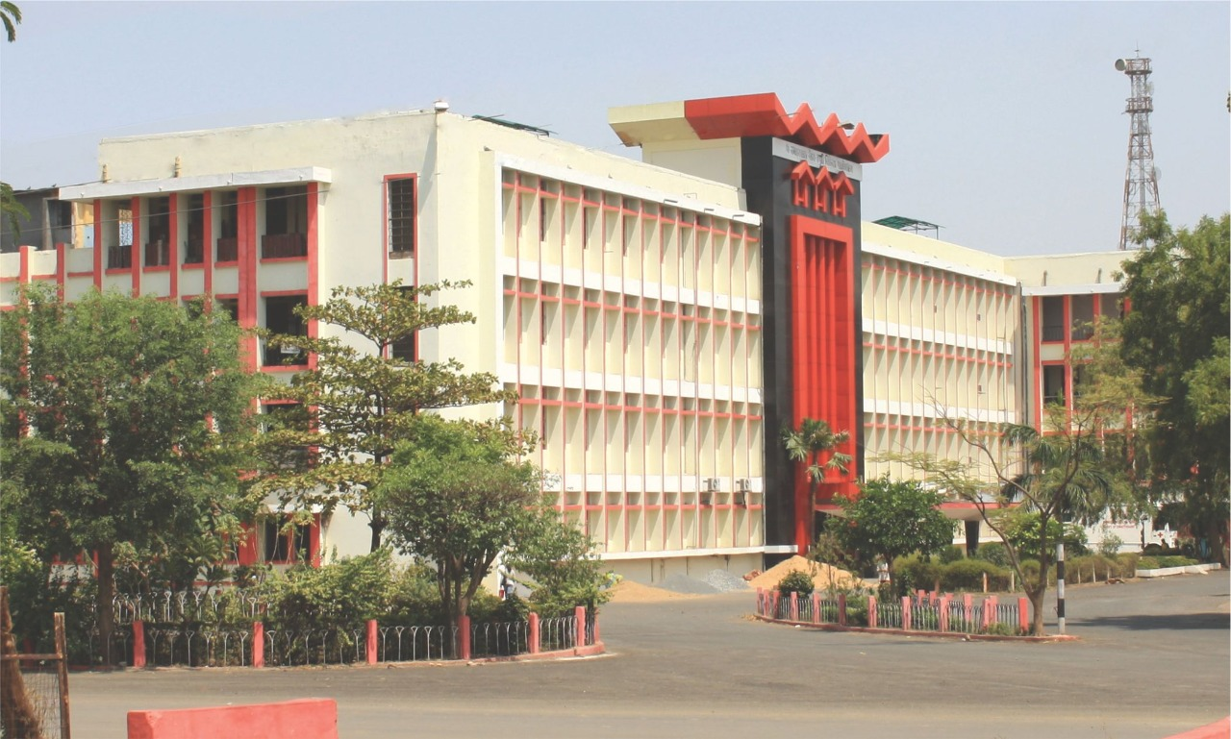
PT. JAWAHARLAL NEHRU MEMORIAL MEDICAL COLLEGE AND DR.BHIMRAO AMBEDKAR MEMORIAL HOSPITAL ,RAIPUR (CHHATISGARH)
To study the thyroid hormone profile in women presenting with AUB at gynecology OPD DR. BRAMH Raipur.
Guide-DR. Jyoti Jaiswal
Co-guide- Dr. Smrity Naik
Presented by DR. Shweta Yadav

Slide 2
Introduction
AUB is defined as any bleeding pattern that differs in the regularity, frequency, duration and amount from a pattern observed during a normal menstrual cycle or menopause.
worldwide incidence of AUB is 10- 30 %.
It is presented in the form of heavy menstrual bleeding (HMB), infrequent menstrual bleeding and frequent menstrual bleeding.
AUB includes both structural and non-structural causes.
Structural causes are PALM i.e. polyp, adenomyosis, leiomyomas, malignancies can be diagnosed with examination and radio logically.non-structural causes include COEIN i.e. coagulopathy, ovulatory dysfunction, endometrial causes, iatrogenic and non-classified causes.

Slide 3
Women with HMB have a significant impact on physical, emotional, social, professional and family perspectives.
Worldwide incidence of thyroid disorders is 10- 30 %
Thyroid dysfunction is a cause of nonstructural AUB. Thyroid is closely linked with the process of ovarian maturation and endometrial hyperplasia.
Females with thyroid gland abnormality have high chances of menstrual irregularity.

Slide 4
AIM & OBJECTIVE
To study thyroid hormone profile in women presenting with AUB.
To measure Thyroid hormone levels (T3,T4,FT3,FT4,TSH) in cases with AUB.
To see the prevalence of hypothyroidism and hyperthyroidism in the study population.
To know the bleeding pattern in cases of hypo and hyper thyroid disorders.
To know the endometrial thickness in various types of thyroid disorder

Slide 5
Methods
This was cross sectional observational study from January 2020 to December 2020, 100 cases of AUB attending Gynecology OPD (Dr. B.R.A.M. Hospital Raipur) were taken in the study.
INCLUSION CRITERIA
All women between 18-45 yrs with abnormal uterine bleeding.
No obvious genital lesion.
Not on hormonal therapy.
No evidence of any haematological disorder.
EXCLUSION CRITERIA
Unwilling cases.
cases suspected of pelvic infection
Woman on oral contraceptives.
case with malignant lesion of cervix
IUCD users
Cases already in treatment for derranged thyroid hormone

Slide 6
RESULT
Table.1 Age wise distribution of study subjects
Age Group | No. Of cases | Percentage
18-24 years | 15 | 15%
25-31 years | 14 | 14%
32-38 years | 25 | 25%
>=39 years | 46 | 46%
Total | 100 | 100%

Slide 7
Table 3: Distribution of Cases According to Parity
Parity | No. Of cases | Percentage
Nullipara | 25 | 25%
P1 | 06 | 06%
P2 | 28 | 28%
Multipara | 41 | 41%
Total | 100 | 100%

Slide 8
Table 4 .Volume of uterus according to USG finding
Volume of uterus | No. Of cases | Percentage
Less than 100 cc | 81 | 81%
100-150cc | 08 | 8%
150- 200cc | 05 | 5%
200-250cc | 03 | 3%
More than 250 cc | 03 | 3%
Total | 100 | 100%

Slide 9
Table 5: Type of Thyroid Dysfunction
Type of Thyroid Dysfunction | Number 0f cases | Percentage
Normal | 71 | 71%
Subclinical hypothyroidism | 02 | 02%
Hypothyroidism | 20 | 20%
Hyperthyroidism | 07 | 07%
Total | 100 | 100%

Slide 10
Table 6: Menstrual Pattern of AUB
Menstrual Pattern | No. Of cases | Percentage
Amenorrhea | 4 | 04%
HMB | 52 | 52%
infrequent menstrual bleeding | 15 | 15%
frequent menstrual bleeding | 20 | 20%
Light menstrual bleeding | 09 | 09%
Table 7: Endometrial thickness in USG
Endometrial thickness | No. Of cases | Percentage
Less than 5 mm | 29 | 29%
5.1-10 mm | 49 | 49%
10.1- 15mm | 17 | 17%
>15.1 mm | 5 | 05%

Slide 11
Table 8 : Types of Abnormalities in AUB
Abnormility | No. Of cases | Percentage
AUB-L | 37 | 37%
AUB-A | 17 | 17%
AUB-O | 14 | 13%
AUB-M | 10 | 10%
AUB-E | 00 | 00
AUB-P | 02 | 02%
AUB-A,M | 03 | 03%
AUB-L,M | 01 | 01%
AUB | 15 | 15%
AUB-P,O,M | 01 | 01%
total | 100 | 100%

Slide 12
Table 9 . Relation of thyroid disorder with type of abnormal uterine bleeding
TYPES OF AUB | HYPOTHYROIDISM | HYPERTHYROIDISM
AUB-L | 05 | 05
AUB-A | 08 | 00
AUB-O | 04 | 00
AUB-M | 02 | 00
AUB | 03 | 02
Table no. 10-menstrual pattern in thyroid disorder
Menstrual pattern | Hypothyroidism | Hyperthyroidism
Heavy and prolonged menses | 12 | 03
Frequent bleeding | 07 | 00
Infrequent bleeding | 03 | 04
Total | 22 | 07

Slide 13
DISCUSSION AND CONCLUSION
There is significant association between thyroid disorde and AUB, AUB is more common in hypothyrodism.
Work up of any patient with AUB should essentially undergo TSH level alongwith T3, T4, otherwise subclinical hypothyroidism may be missed if only TSH levels are measured.
Incidence of AUB increases with AGE.
Multiparous women are more commonly affected.
Frequent complains were heavy menstrual bleeding, generalized weakness, lethargy.
Cases affected with thyroid dysfunction if given treatment can avoid hormonal and surgical intervention.

Slide 14
References
Byna P. et al. Thyroid abnormality in perimenopausal women with abnormal uterine bleeding International journals of Research in Medical Sciences 2015 nov;3(11):3250-325.
Mohanadhanpal, Nesse R, Pudubidri VG, Alben JR et al Abnormal uterine bleeding Am FamPhys, William J Butler,Yu Sun.
Talukdar B, Mahels S.2016.
FIGO recommendation on terminologies Ian S. Fraser.
7th June 2011 FIGO has approved new classification PALM COEIN classification.
Sharma N Sharma thyroid profile in menstrual disorders 2012;14(1):14-7
Gowri M, et al thyroid function test in women with AUB.2014;3(1):54-7

