Slide 1


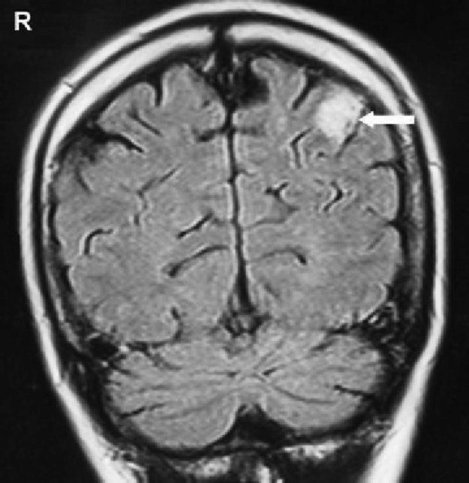
EXPECT THE UNEXPECTED – A RARE CASE OF ATYPICAL PRESENTATION
OF LATE POSTPARTUM ECLAMPSIA AND PRES
Authors Dr.E.Nandhini (3rd year post graduate), Prof. Dr.Deepa Shanmugam
Aarupadai Veedu Medical College and Hospital, Pondicherry.
INTRODUCTION
DISCUSSION
Even though pregnancy is considered as a physiological process, complications can arise at any time, making the obstetrician always be alert at expect the unexpected.
Here we present a rare and atpical presentation of postpartum eclampsia and PRES.
PRES is a clinico radiographic syndrome
Etiology: Preeclampsia, Eclampsia, Acute or Chronic Renal Disease, Electrolyte imbalance, Use of Cytotoxic and Immunosuppressant drugs,sepsis,Sickle cell disease.
Pathophysiology : 1) Cerebral vasoconstriction causing subsequent infarcts in the brain, 2) failure of cerebral auto-regulation with vasogenic edema, and 3) endothelial damage with blood-brain barrier disruption further leading to fluid and protein transudation in the brain.
Clinical features of PRES include headaches, an altered mental status, seizures and visual loss and neuroimaging is essential for confirming the diagnosis.
MRI finding PRES: There is a predominant affection of pareito occipital subcartical white matter of both hemispheres. Typically PRES lesion on MRI are thought to have vasogenic edema.
Our case had a atypical lesion on MRI showing left pareito occipital ischemia with differential diagnosis as PRES complicated after Eclampsia. Patient regained vision due to timely intervention.
CASE REPORT
A 38 year old multigravida, booked case, had an eventful antenatal period.
Admitted in latent phase of labour progressed and delivered vaginally.
Throughout her intrapartum period her BP was normal (120/80 mmhg).
Immediate postpartum period she had headache and raised BP (170/120 mmhg).
Started on Pritchards regimen and Nifedipine.
24 hrs later her BP was < 120/80 mm hg without any Antihypertensives.
On 5th PND early morning, she complained of sudden loss of vision, her BP was 170/110 mm hg
Ophthalmologist opinion was obtained had only perception to light in both eyes, probably cortical blindness, fundus was normal.
MRI was taken and it showed Altered signalling changes in left pareito occipital gyral region likely representing ischemic changes due to post Eclampsia
With diagnosis of atypical PRES, she was started on MgSO₄ regimen.
Surprisingly, patient regained her vision after 14 hrs and her BP was also normal during follow-up.
Left parieto occipital cortical hyperintense lesion suggesting ischemia in a coronal slice of FLAIR MRI
CONCLUSION
In our case we had lesion on MRI suggesting post eclamptic changes with clinical features suggesting of PRES
The improved knowledge and research about factors influencing the outcome of PRES will result in better early management, less morbidity and mortality.
Prompt recognition and treatment are crucial to avoid the permanent damage leading to sequelae and even mortality.
Exclude differential diagnosis as fast as possible. Proper initiation of treatment may crucial for the outcome.
REFERENCES
Minnerup J, Kleffner I, Wersching H, et al. Late onset postpartum eclampsia: It is really never too late-a case of eclampsia 8 weeks after delivery. Stroke Res Treat. 2010;2010: 798616.
Parisaei M, Derwig I, Yoon J, et al. Posterior reversible leukoencephalopathy in a case of postpartum eclampsia. Am J Obstet Gynecol. 2005;193:885-886.
Sreenivasa Rao Sudulagunta1, *, Mahesh Babu Sodalagunta2, Monica Kumbhat3 and Aravinda Settikere Nataraju4 1 Columbia Asia Hospital, Kirloskar Business Park, Hebbal, Bangalore, India, 2 K S Hegde Medical College, Ullal, India, 3 Sri Ramachandra Medical College, Chennai, India, and 4 Columbia Asia Hospital, Hebbal, Bangalore, India
Williams book of obstetrics 25th edition.

