Slide 1
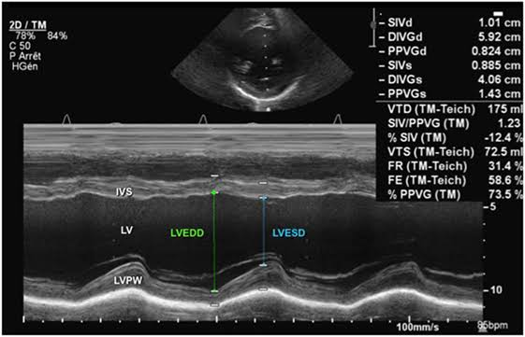
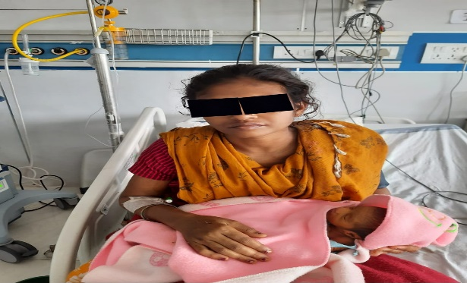
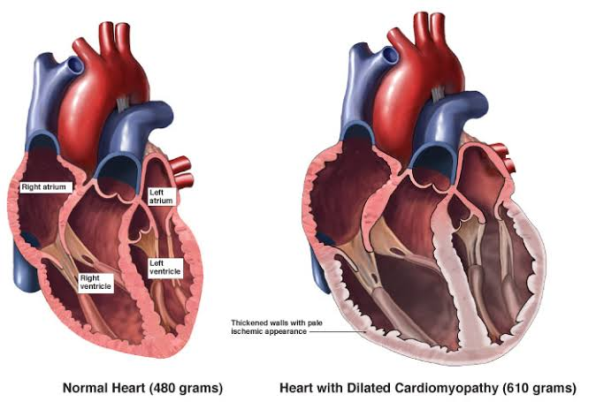
PERIPARTUM CARDIOMYOPATHY :STRONG SUSPICION AND QUICK MANAGEMENT SAVES THE MOTHER
Presented by: Dr. Anshu Agrawal, Guided by: Dr. Ruchi Kishore, Dr. Neelam Singh, Dr. Smrity Naik, Dr. Pratibha Lambodari, Dr. Anjum Khan
Dilated heart of pregnancy, Suspect & manage to BIG HEART OF MOTHERHOOD…….
Case:-
A 29yr,2nd gravida with twin pregnancy presented to labour room at 36 weeks of gestation in active phase of labour. A booked case with uneventful 1st and 2nd trimester. She developed breathing difficulty in lying down position 2 days before admission. Her previous pregnancy and birth were uneventful. She never had heart disease.
She was afebrile with pulse rate of 82bpm regular. Her BP was 110/70mmhg, RR -18/min, spo2 was 98% in room air. She had no pallor icterus or cyanosis. She had pedal oedema pitting, up to ankles. Chest -clear with normal vesicular bilateral equal breath sound and S1S2 was normal, no added sounds.
On gynaecological examination uterus was overdistended due to twin pregnancy, both foetus were in longitudinal lie with cephalic presentation with regular heart rate. She was having 3 uterine contractions in 10 min each lasting 35-40 seconds.
On pervaginum examination cervix was 6-7cm dilated and 90% effaced membranes were absent, vertex was at zero station and pelvis-adequate.
Antenatal investigations - WNL. ECG was WNL. She was given a normal trial of labour.
Soon after the delivery of 1st twin she had acute breathlessness, her saturation fall down to 60% at room air. Her pulse -134bpm and RR -34/min, chest - full of coarse crepitations. Legs were taken up from stirrups, propped up position . Oxygen inhalation with high flow mask at 16liters/min, Injection furosemide 20mg IV.
Echocardiography showed global left ventricular hypokinesia with moderate MR mild TR ejection fraction 30-35% no clots or vegetation IVC was 1.93cm(dilated) s/o Peripartum Cardiomyopathy.
While stabilizing the patient, 2nd twin FHS was irregular and decreasing.
Managed in the form of Inj. furosemide, NIV support and digoxin. 2nd baby delivered after 3hours(stillborn). Delivery was conducted in propped up position on NIV support and outlet forceps was applied. After delivery inj. Furosemide was again given(total 70mg) and slow IV infusion of oxytocin 2U over 10min followed by 12Mu/min for 4 hours was started to prevent post partum haemorrhage.
Her general condition improved gradually and was discharged after 7 days on tablet digoxin with the baby.
Discussion:-
Present case needs to be reported as the women went into cardiac failure just after delivery of 1st baby and 2nd baby was still inside the womb.
Here there were two main challenges for the obstetrician; one was to delivery the 2nd twin, and another was to prevent further worsening of the cardiac failure. Delivery was conducted in the presence team of obstetrician anaesthetist and physician.
Treatment of PPCM is same as for other forms of Congestive heart failure. About 50% of women regain their ejection fraction. Recurrence rate is 30%.
This is a rare case where timely recognition and management could save patients life.
Introduction:-
PPCM is a rare dilated cardiomyopathy with unknown aetiology. Incidence - 1in 3000-4000 live birth.
The diagnostic criteria –
1)Development of cardiac failure in last month of pregnancy or within 5 months of delivery.
2) No identifiable cause of cardiac failure.
3)No identifiable heart disease before last month of pregnancy.
4) Left ventricular dysfunction manifested as ejection fraction <45%.
Multiparity
black race
older maternal age
Hypertension
multiple pregnancy
fatigue
dyspnoea
oedema
Mimics pulmonary oedema due to pre eclampsia, pulmonary embolism and severe anaemia.
Risk factor
Clinical presentation
Reference
Kaavya, M., & Saraswathi, K. (2016). Peripartum Cardiomyopathy - A Case Report. IOSR Journal of Dental and Medical Sciences, 15(5), 55-58.
Kumari, A., Singh, S., Singh, S., & Chaturvedi, M. (2012). Peripartum Cardiomyopathy: A Review of Three Case Reports. Journal of South Asian Federation of Obstetrics and Gynaecology, 4(3), 164-166.

