Slide 1
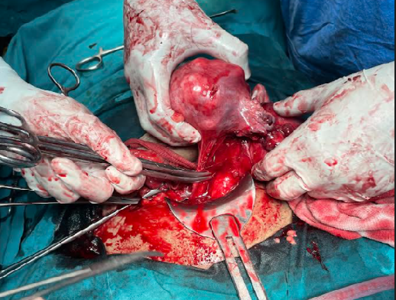
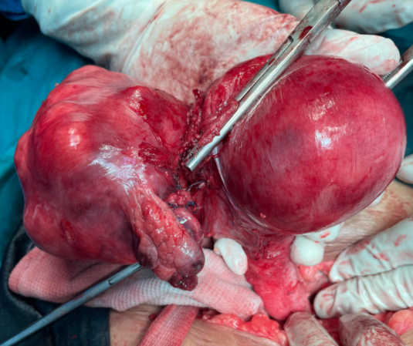
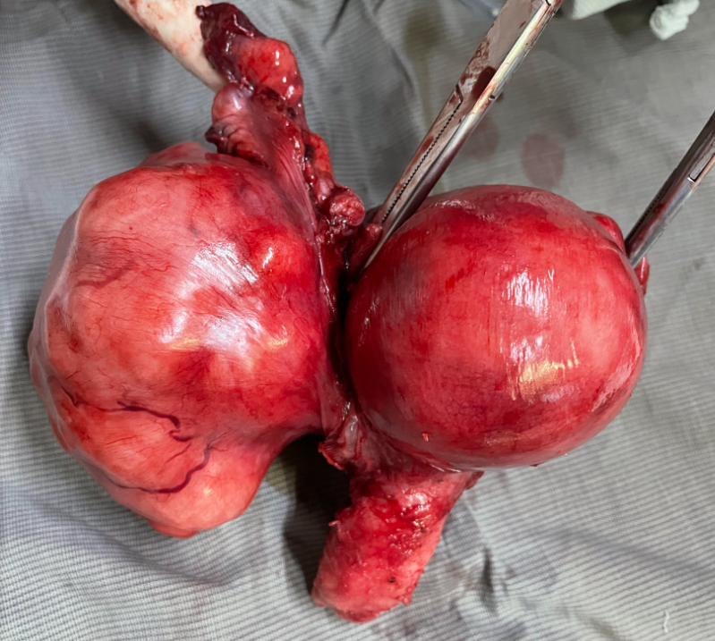
f
FALLOPIAN TUBE LEIOMYOMA : A RARE PRESENTATION
Dr. Nehakumari Parmar(PG), Dr. Gurpreet Kaur(Prof.), Dr. Archana Meravi (Asst. Prof.)
While leiomyoma are the most common tumours of the uterus,leiomyoma of the fallopian tubes is extremely rare.
Though the uterus and tubes are derived from Mullerian system and both contain smooth muscles,fallopian tubes leiomyoma is least frequently encountered.
Most cases are asymptomatic and found incidentally at unrelated operation or at autopsy.
They have never been diagnosed pre-operatively and the diagnosis has only been confirmed after histopathological examination.
A rare presentation of fallopian tube leiomyoma presented with urinary complaints is reported here.
Perioperatively, the large calcified mass was found extending from fundal region to right fallopian tube and part of ovary& upto right cervical region with distorted anatomy.There was urinary bladder diverticulum.
Total abdominal hysterectomy along with right salphingoopherectomy was performed.
Histopathologically report revealed mass to be right fallopiantube leiomyoma .
The patient had an uneventful recovery.
uterus
uterus
FT fibroid
A 40 years old,married Indian women,para 1was admitted to hospital with complaints of recurrent burning micturition & difficulty in micturition with continuous lower abdomen pain & discomfort for 2 months.
She had 5/28-32 days/regular menstrual cycle with average flow.
Her vitals were stable
On per abdominal examination an ill defined mass ~14wks size,non tender.
On per vaginum examination a mass ~14 wks sized attached to uterus with restricted mobility felt in right adnexa.
Leiomyoma of fallopian tube are rare, typically co-incidental finding at surgery or at autopsy.
They are mostly single,small & unilateral but may be variable size from microscopic to >15cm size.
They may grow excessively and undergo torsion and degenerations
They are rarely diagnosed pre-operatively.
Laparoscopy can be used for definite diagnosis & management.
Though final diagnosis is made on HPE.
Asymptomatic fallopian tube leiomyoma being chance-findings are very rare and symptomatic large fallopian tube leiomyoma as in this case are still rarer.
This condition should be kept in mind as a differential diagnosis of any adnexal mass.
USG reported large multiple uterine fibroids in fundal region,anterior myometrium and cervical regions with calcific degenerative changes within it & shows peripheral vascularity on doppler
uterus-14*7*10cm ET-6mm
Her CBC was normal.
Her other routine lab investigations were within normal range.
Misao R,Niwa K,Iwagaki S,et.al.Leiomyoma of fallopian tube.Gynecol obstet invest.2000;49(4):279-280.
Tarek Bardawail.Fallopian tube disordes.Medscape,USA;2014.
Punyabatra Mohapatra,sahadev sahoo,Rabindra nath behera,et al.journal of evolution of medical and dental sciences2014;vol.3Issue66
Email:nehaparmar.56.np@gmail.com contact:9981434956

