Slide 1


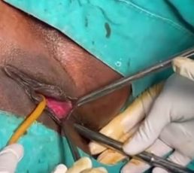
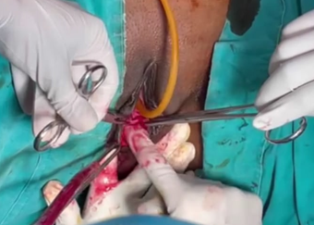
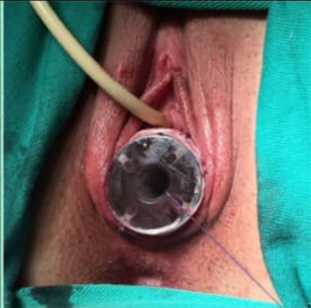
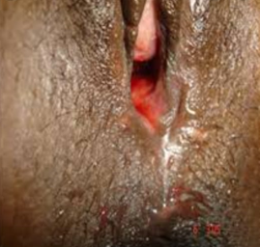
Mayer-Rokitansky-Küster-Hauser (MRKH)syndrome is characterized by congenital aplasia of uterus and upper part(2/3) of vagina with normal development of secondary sexual characteristics and 46,XX karyotype. It affects approximately 1 of 4500 women and may be associated with vaginal atresia.
Correction of Vaginal atresia by McIndoe procedure -A Case Report
Dr. Uttara Gupta (PG 3rd year), Dr. Rekha Sapkal (Professor and HOD)
People’s College of Medical Sciences & Research Centre, People’s University, Bhopal
CASE REPORT
A 24 year old patient with Primary Amenorrhea. She had no history of virilization, Acne, weight gain, Hirsutism, TB, intolerance to heat, constipation, hoarseness of voice, pigmentation.
No h/o cyclical pain abdomen, lump abdomen, urinary complaints, recurrent colitis attacks, Radiation exposure, any viral infection or exposure to drugs during intrauterine life, no anosmia.
Patient had history of Diagnostic laparoscopy 4 years back, in which rectovaginal septum seen between bladder and mid part of rectum, and diagnosis of MRKH was made. Patient advised reconstruction surgery of Vagina before marriage.
On examination, average built, height 158 cm, BMI 20.4Kg/m2, no stigma of turner syndrome, no galactorrhea,/goitre, no evidence of ectopic gonads. All secondary sexual characters breast, pubic and axillary hair developed to Tanner 5.
Local Examination- No clitoromegaly/ hypospadius, Labial folds normal, anal sphincter in normal position, Vaginal pouch<2cm, perineal body present.
Per Abdomen- soft, non tender, no organomegaly. PerRectal-uterus not felt, no mass felt.
Less than 2 cm Vaginal pouch
Blunt dissection by finger
Vaginal mould inserted
Neovagina after 1 month
PROCEDURE
Patient admitted for reconstructive surgery of vagina, by McIndoe repair under USG guidance.
Under anesthesia, catherization done and bladder distended by 100 ml Normal saline, vision established under USG.
Per rectal digital examination done, metal dilator introduced to identify anterior wall of rectum.
Transverse incision given 2 cm below the urinary meatus, space dissected with finger in forward direction avoiding injury to rectum and bladder.
Approximately 8 cm pouch created and adequate size of vaginal mould kept with thigh skin graft.
Catherization done for 24 hours. Post operatively period was uneventful. Mould removed on post operative day 8 and after ensuring proper epithelization, patient was discharged.
Patient instructed regarding insertion and cleaning of vaginal mould.
In follow up, after 1 month, 8 cm vaginal pouch was found intact, with no scarring, or infection.
Email- uttaragupta.rntmc@gmail.com Contact- +91 9461016262

