Slide 1

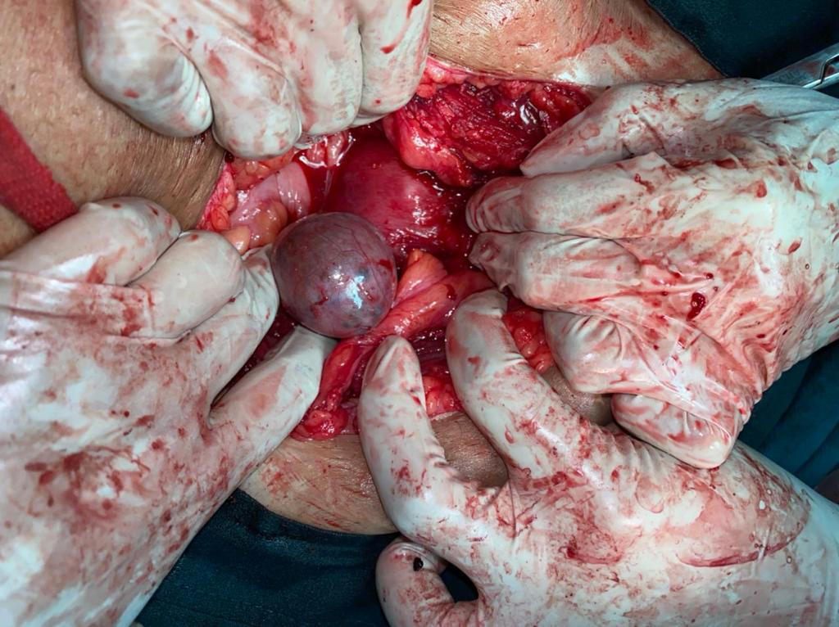
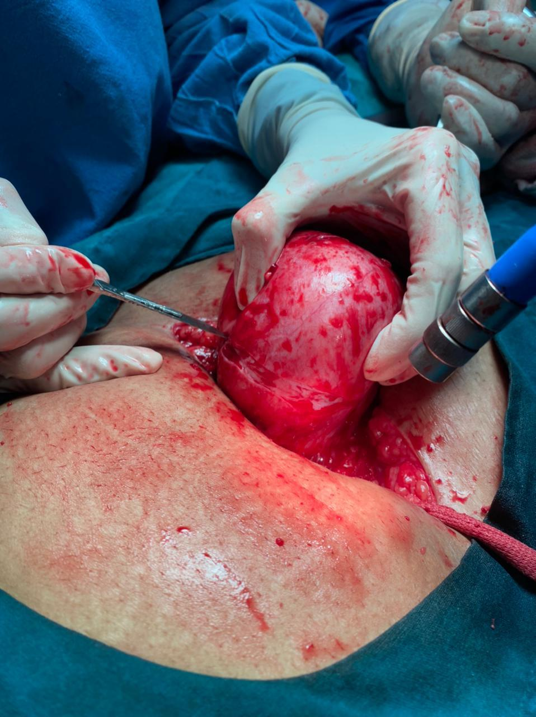
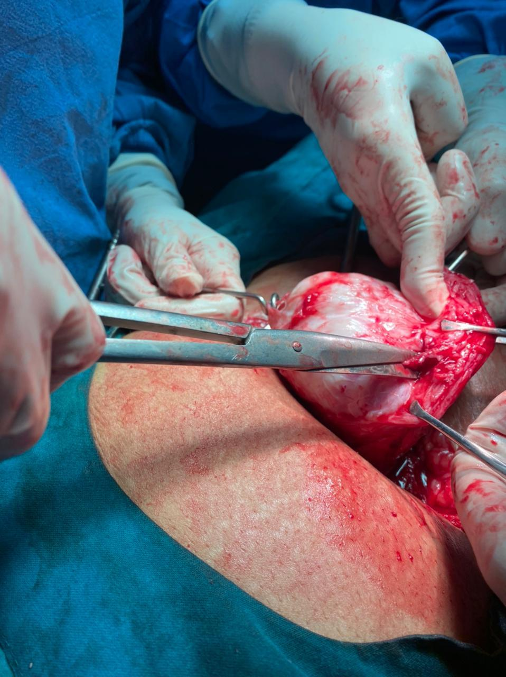
A CASE REPORT OF FIBROID UTERUS WITH RIGHT OVARIAN ENDOMETROSIS
Dr. Priyanka Sachdeva (PG 2nd year), Dr. Rekha Sapkal (Professor and HOD)
Peoples College of Medical Science, Bhopal (M.P.)
38 year female had painful heavy menstrual bleeding since 3 years. Received hormonal progestogens for 9 months .
P1L1A1 last child birth was FTCS 5 yrs back .no uterine pathology identified during section.
General examination was normal. on Abdomen exam uterus 14 week Deviated to right side tenderness over uterus +.
Vaginum examination –
Uterus was fixed retroverted 14 weeks firm irregular
USG Anterior wall right subserosal fibroid of 7.5x6.5cm,
Hypoehoic lesion of 3.5x2.3 cm hemorrhagic cyst? endometriotic?
Right ovary 5x4 cm & left ovary 2.7x1.6cm
Provisional diagnosis - Retroverted fixed uterus with fibroid and adnexal mass (PID) with heavy menstrual bleeding Not responded to medical treatment .After investigations and consent for hysterectomy laparotomy and myomectomy was planned .
Laparotomy - Acutely retroverted completely adherent uterus with rectum .along with subserous 10x10 cm fibroid .5cm x 5 cm right complex ovarian cyst myomectomy followed by Total Hysterectomy with right ovarian cystectomy was done
Histology - Uterus adenomyosis uterus. 4 cm cyst with brownish fluid ooz out .Myometrial bundles with whorling pattern. Proliferative endometrial glands and stroma deep in myometrium.
Adnexal mass Smooth lobulated. Mass with endometriotic ovary.
Discussion - ovarian endometrioma are usually fixed , they do not respond to hormonal treatment .
Conclusion - Surgical excision is the treatment of choice .there is chance of recurrence.
References –
Iker Selcuk and Gurkan Bozdag – Recurrence of endometroiosis; risk factors, mechanisms and biomarkers; review of the literature; Turkish-German Gynecological Association.
Konstantinos Nirgianakis, Lijuan Ma and Michael D. Mueller – Recurrence Patterns after Surgery in Patients with Different Endometriosis Subtypes : A long-term Hospital Based Cohort Study; Journal of Clinical Medicine.

